Slide 1
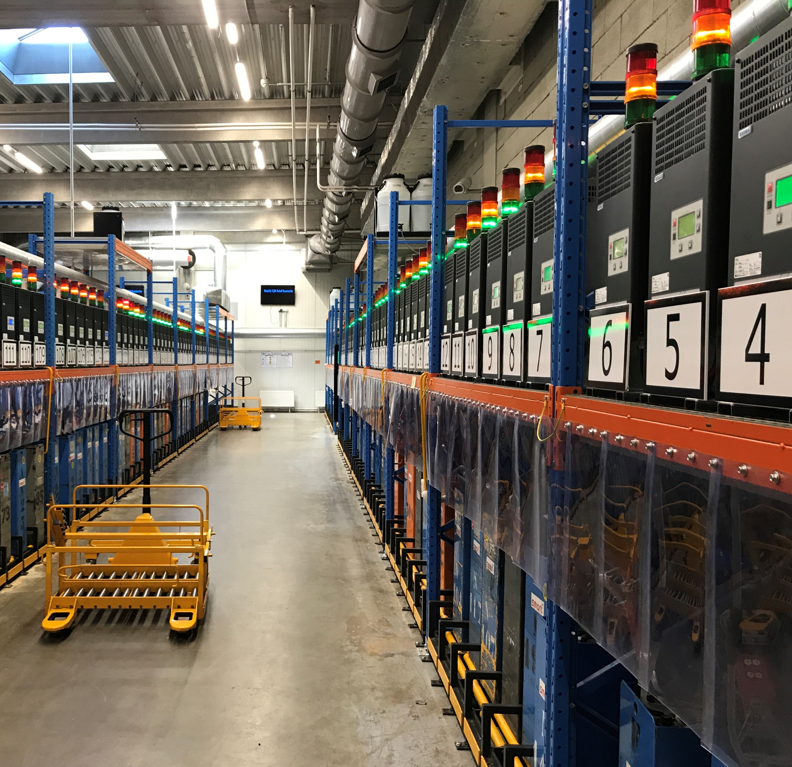
CHARGER MANAGEMENT SYSTEM
SMART system for effective managing and monitoring of the charging station

Slide 2
Introduction
Function
Equipment
Battery Exchange
Main Features
Contents

Slide 3
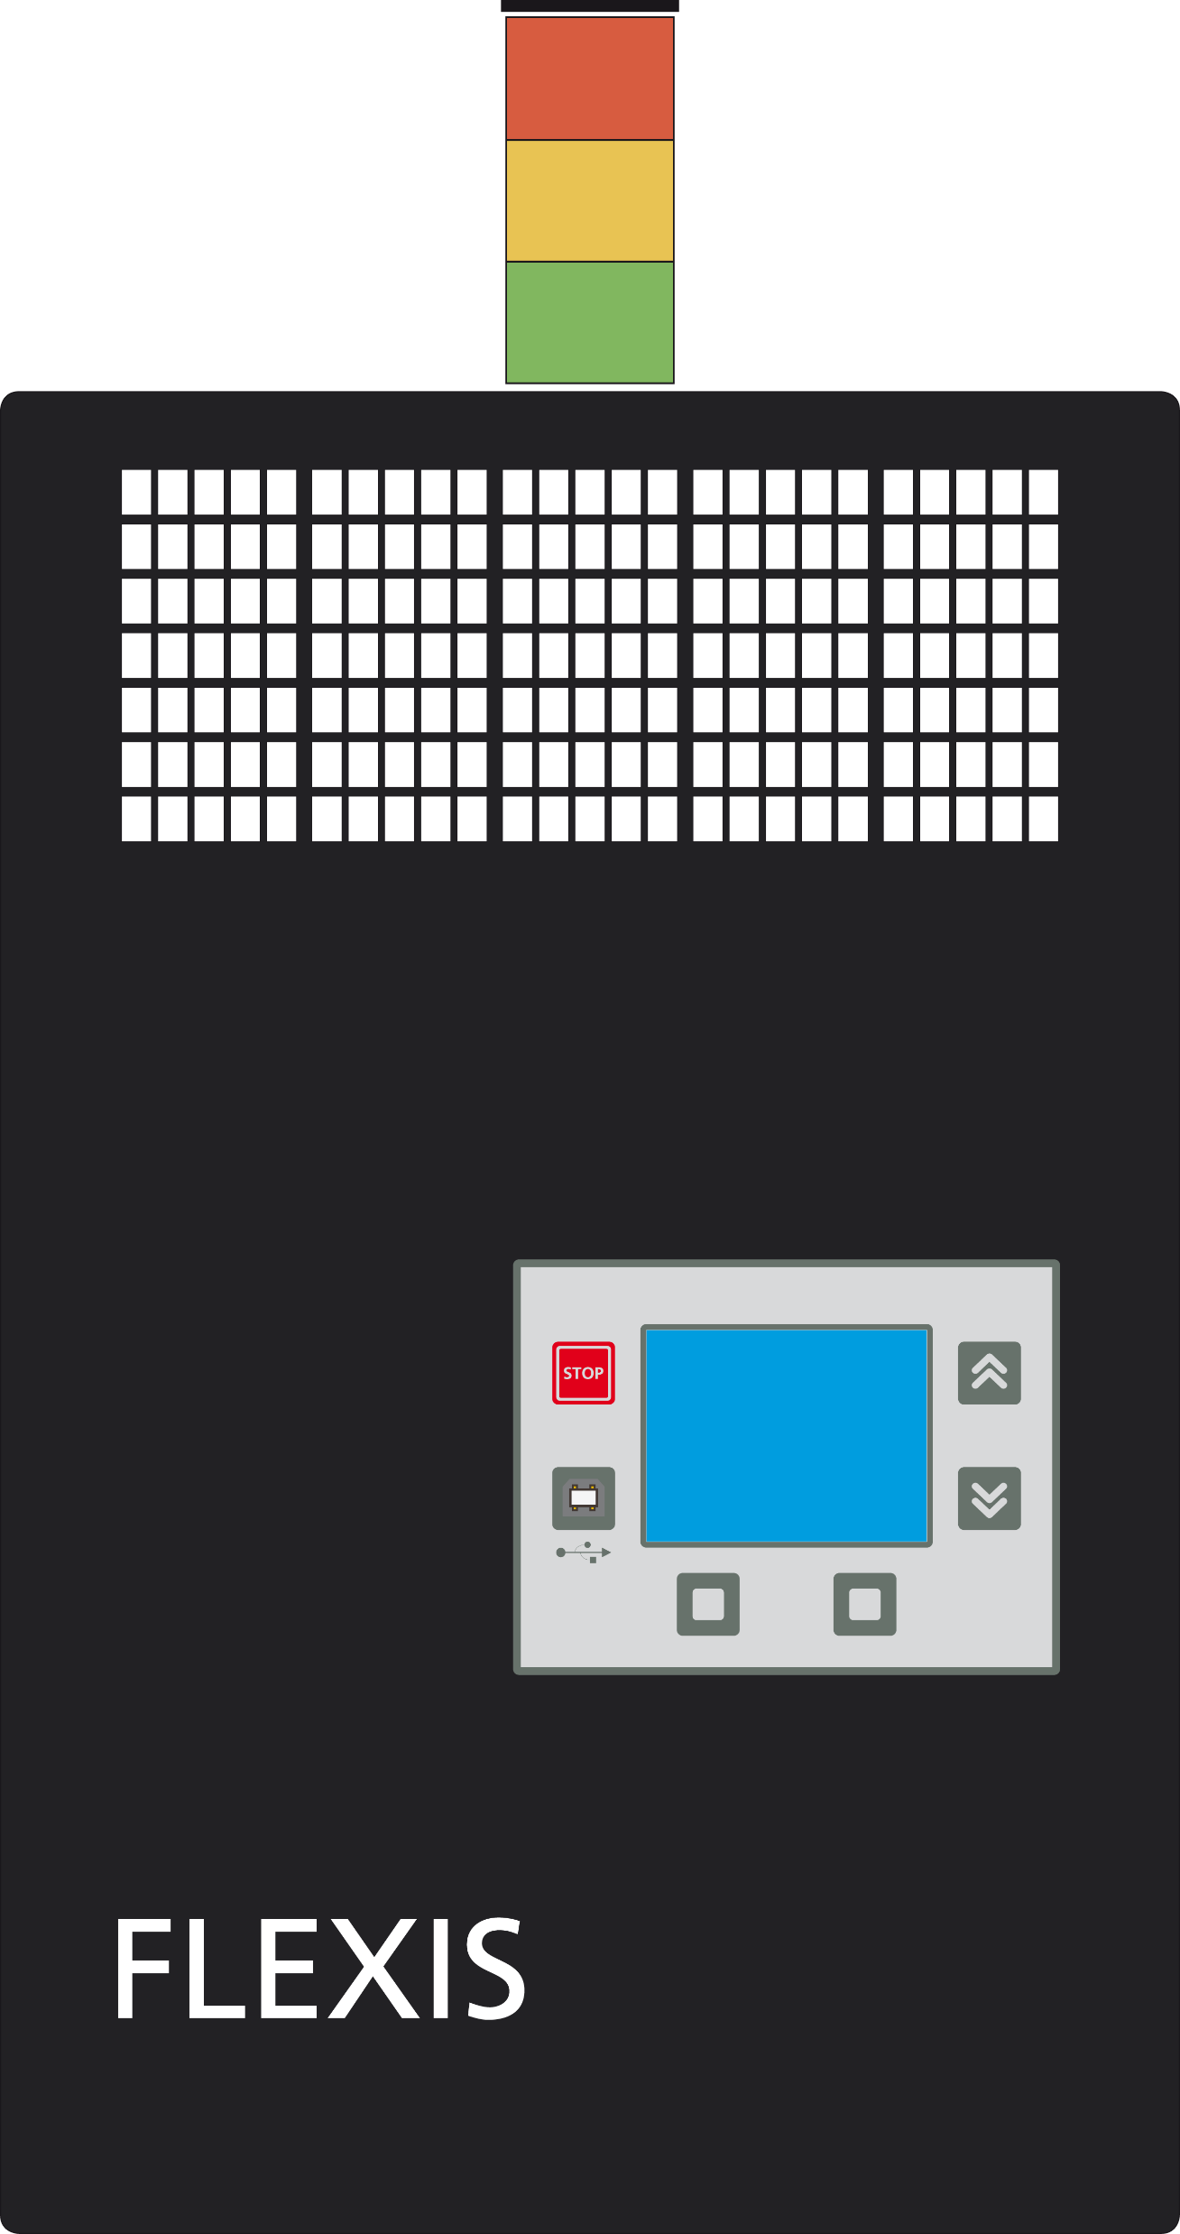
What is it?
AXINET is a smart charger management system. The system optimizes operations in the charging station.
Battery charge and exchange according to the AXINET prolongs its life and reduces operating costs. Main principle of the system is an equal rotation of batteries - each battery has a similar count of charging cycles. The system puts emphasis on ideal battery working time:
8 hours in duty
8 hours charging
8 hours cooling
|

Slide 4
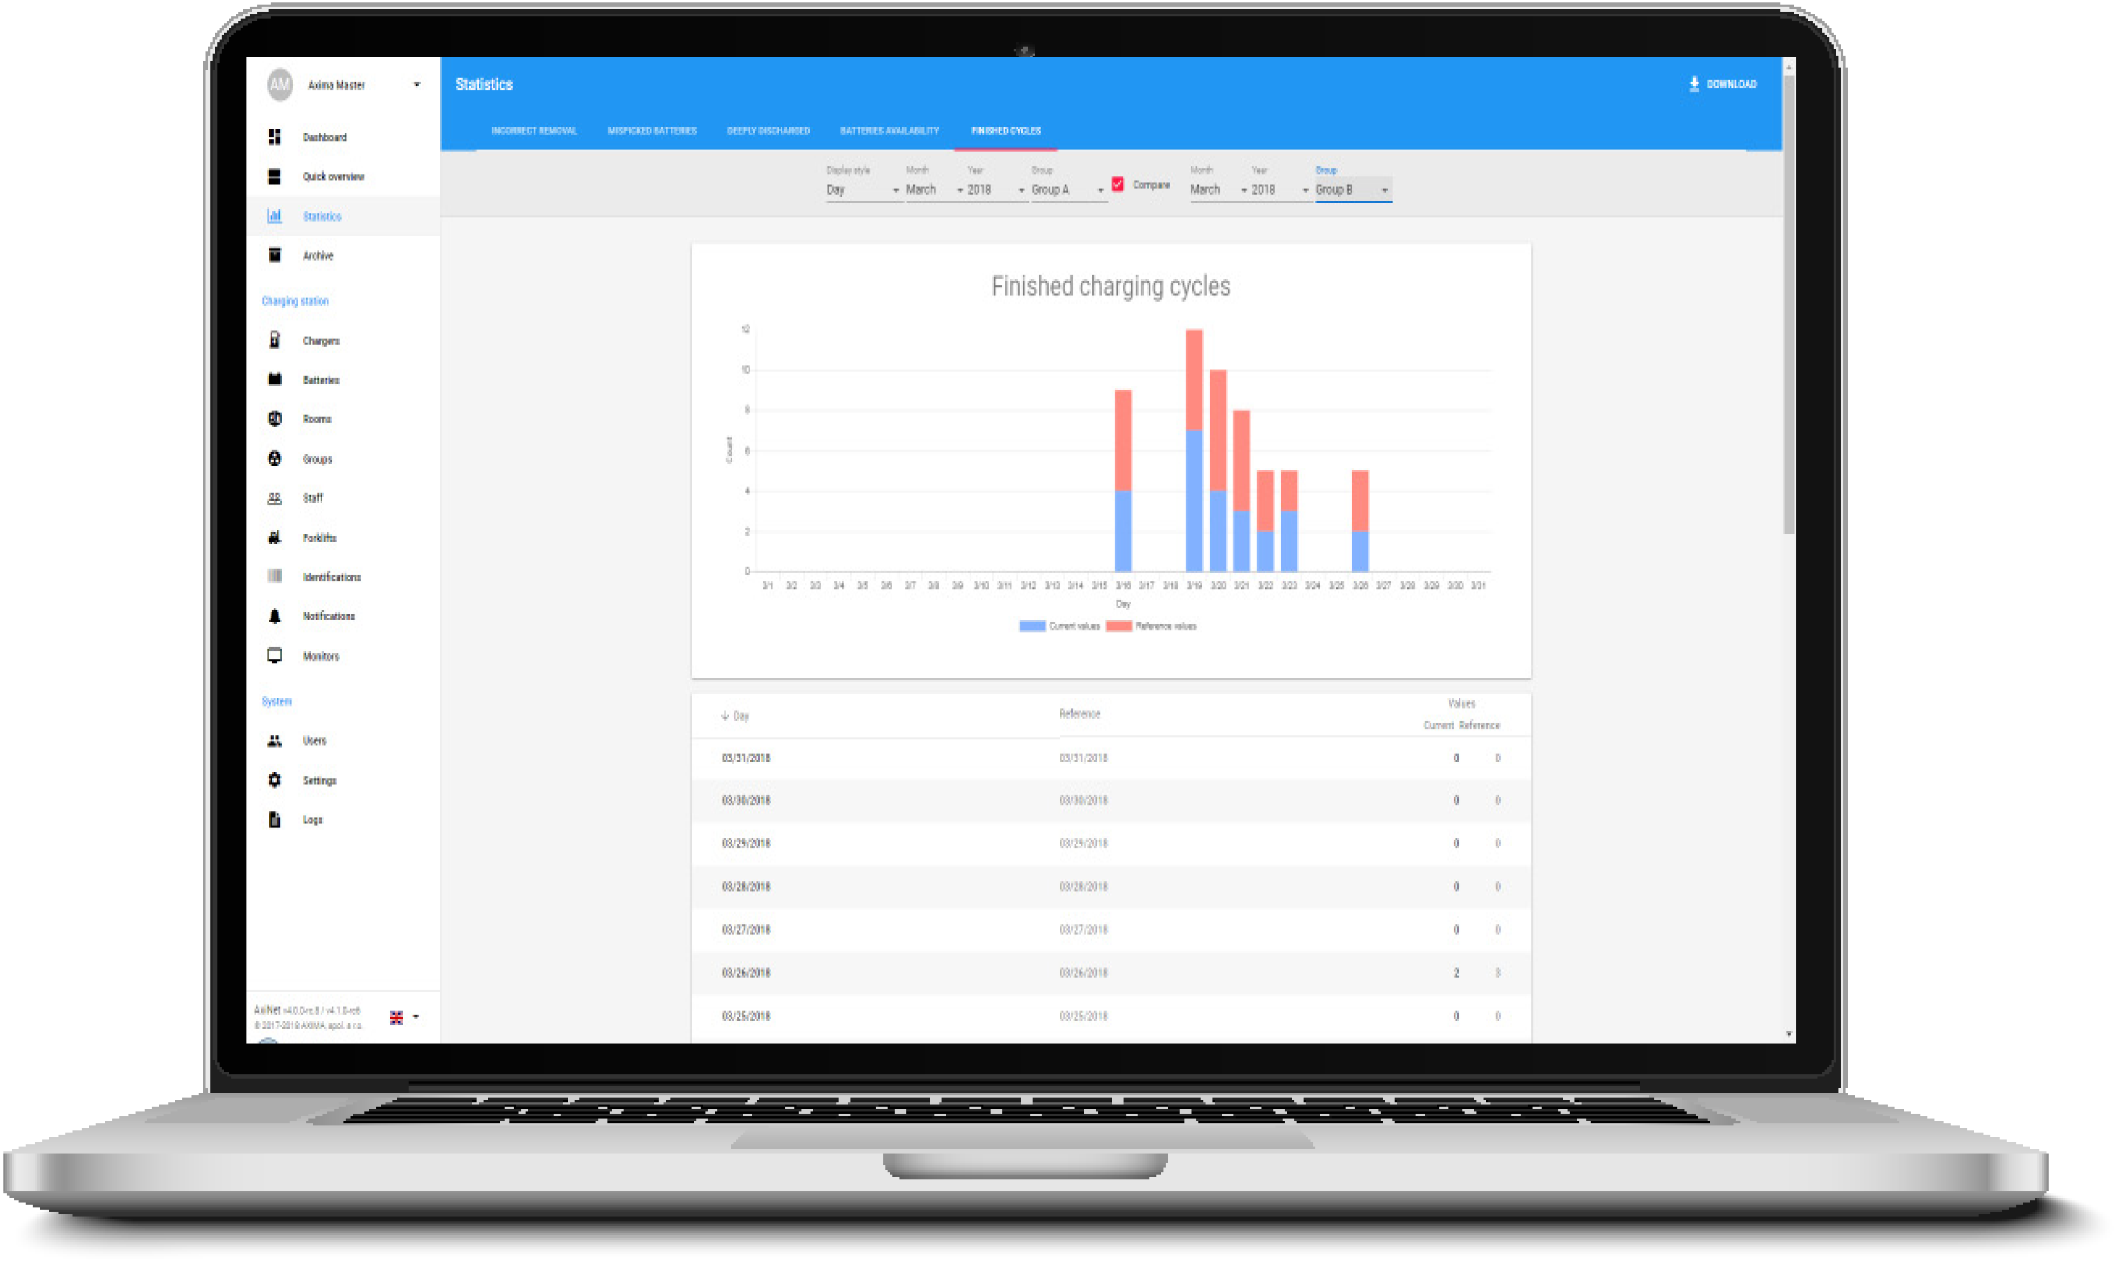
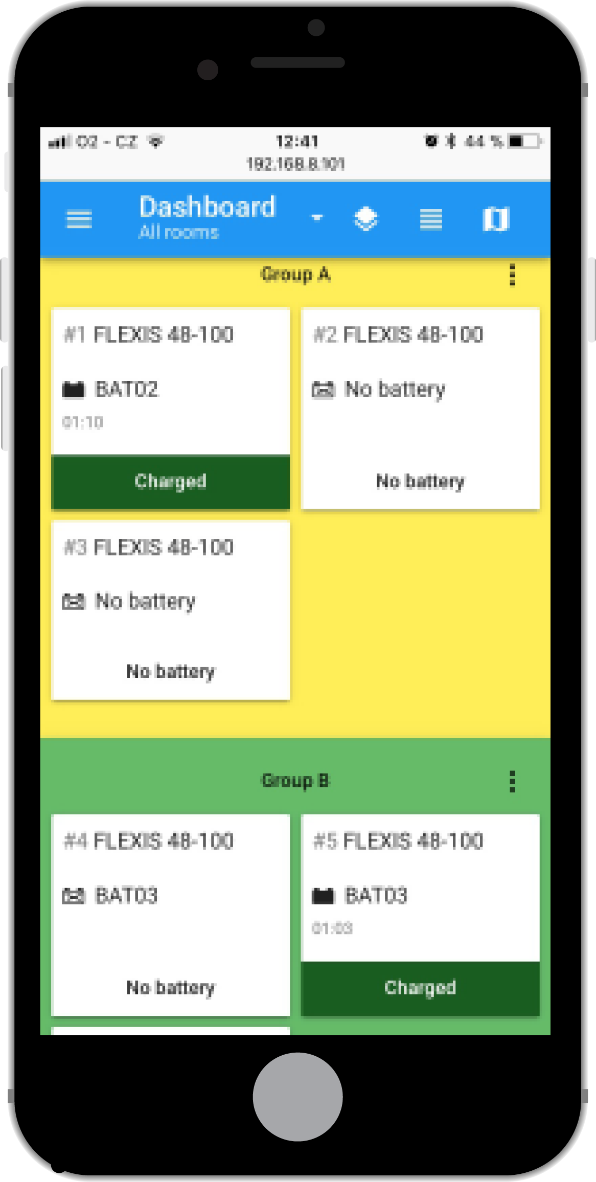
How it works?
Chargers are connected to the network.
Control unit collects data from the chargers.
These data are evaluated by AXINET application.
AXINET application manages battery exchanges and chooses the right positions for battery exchange.
Control unit creates a server and makes web app available in local network.
Remote access module with LTE SIM card allows connection to AXINET application from anywhere.
|

Slide 5
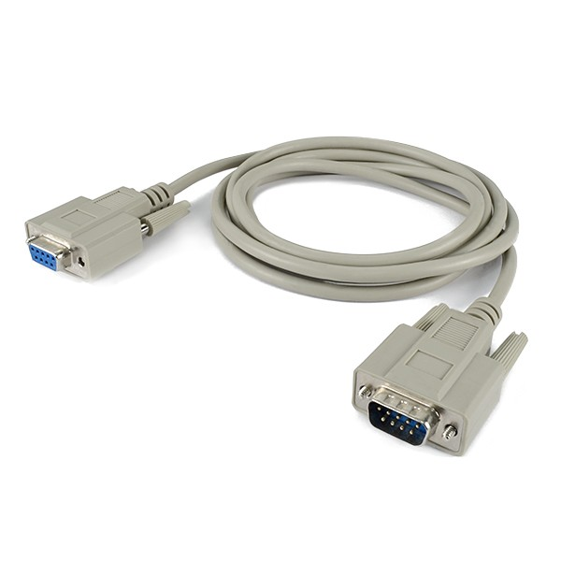
Charger Equipment FLEXIS
Chargers are equiped for service in the AXINET
AXI FF LED - parts of the optical LED signal tower (green, yellow and red)
RS485 cable
CPU MAX - charger control unit
AXI FF 485 – communication board
|

Slide 6
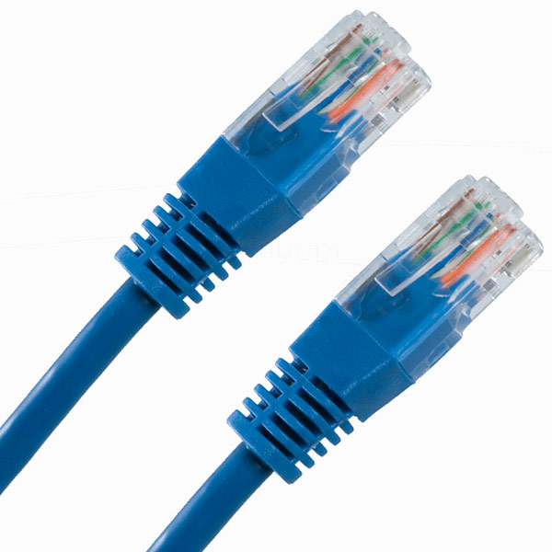
Charger Equipment FLEXIS NG
Chargers are equiped for service in the AXINET
AXI FF LED - parts of the optical LED signal tower (green, yellow and red)
UTP / STP cable
FLEXIS CPU - charger control unit
FLEXIS EXT UNIT– communication board
|

Slide 7
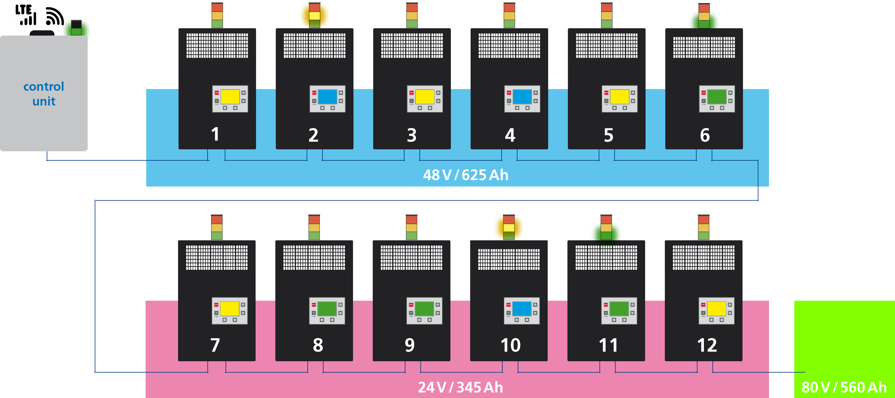
Charger groups
Up to 255 chargers in the network can be divided into many groups by battery type, forklift type…
up to 255 chargers
|

Slide 8
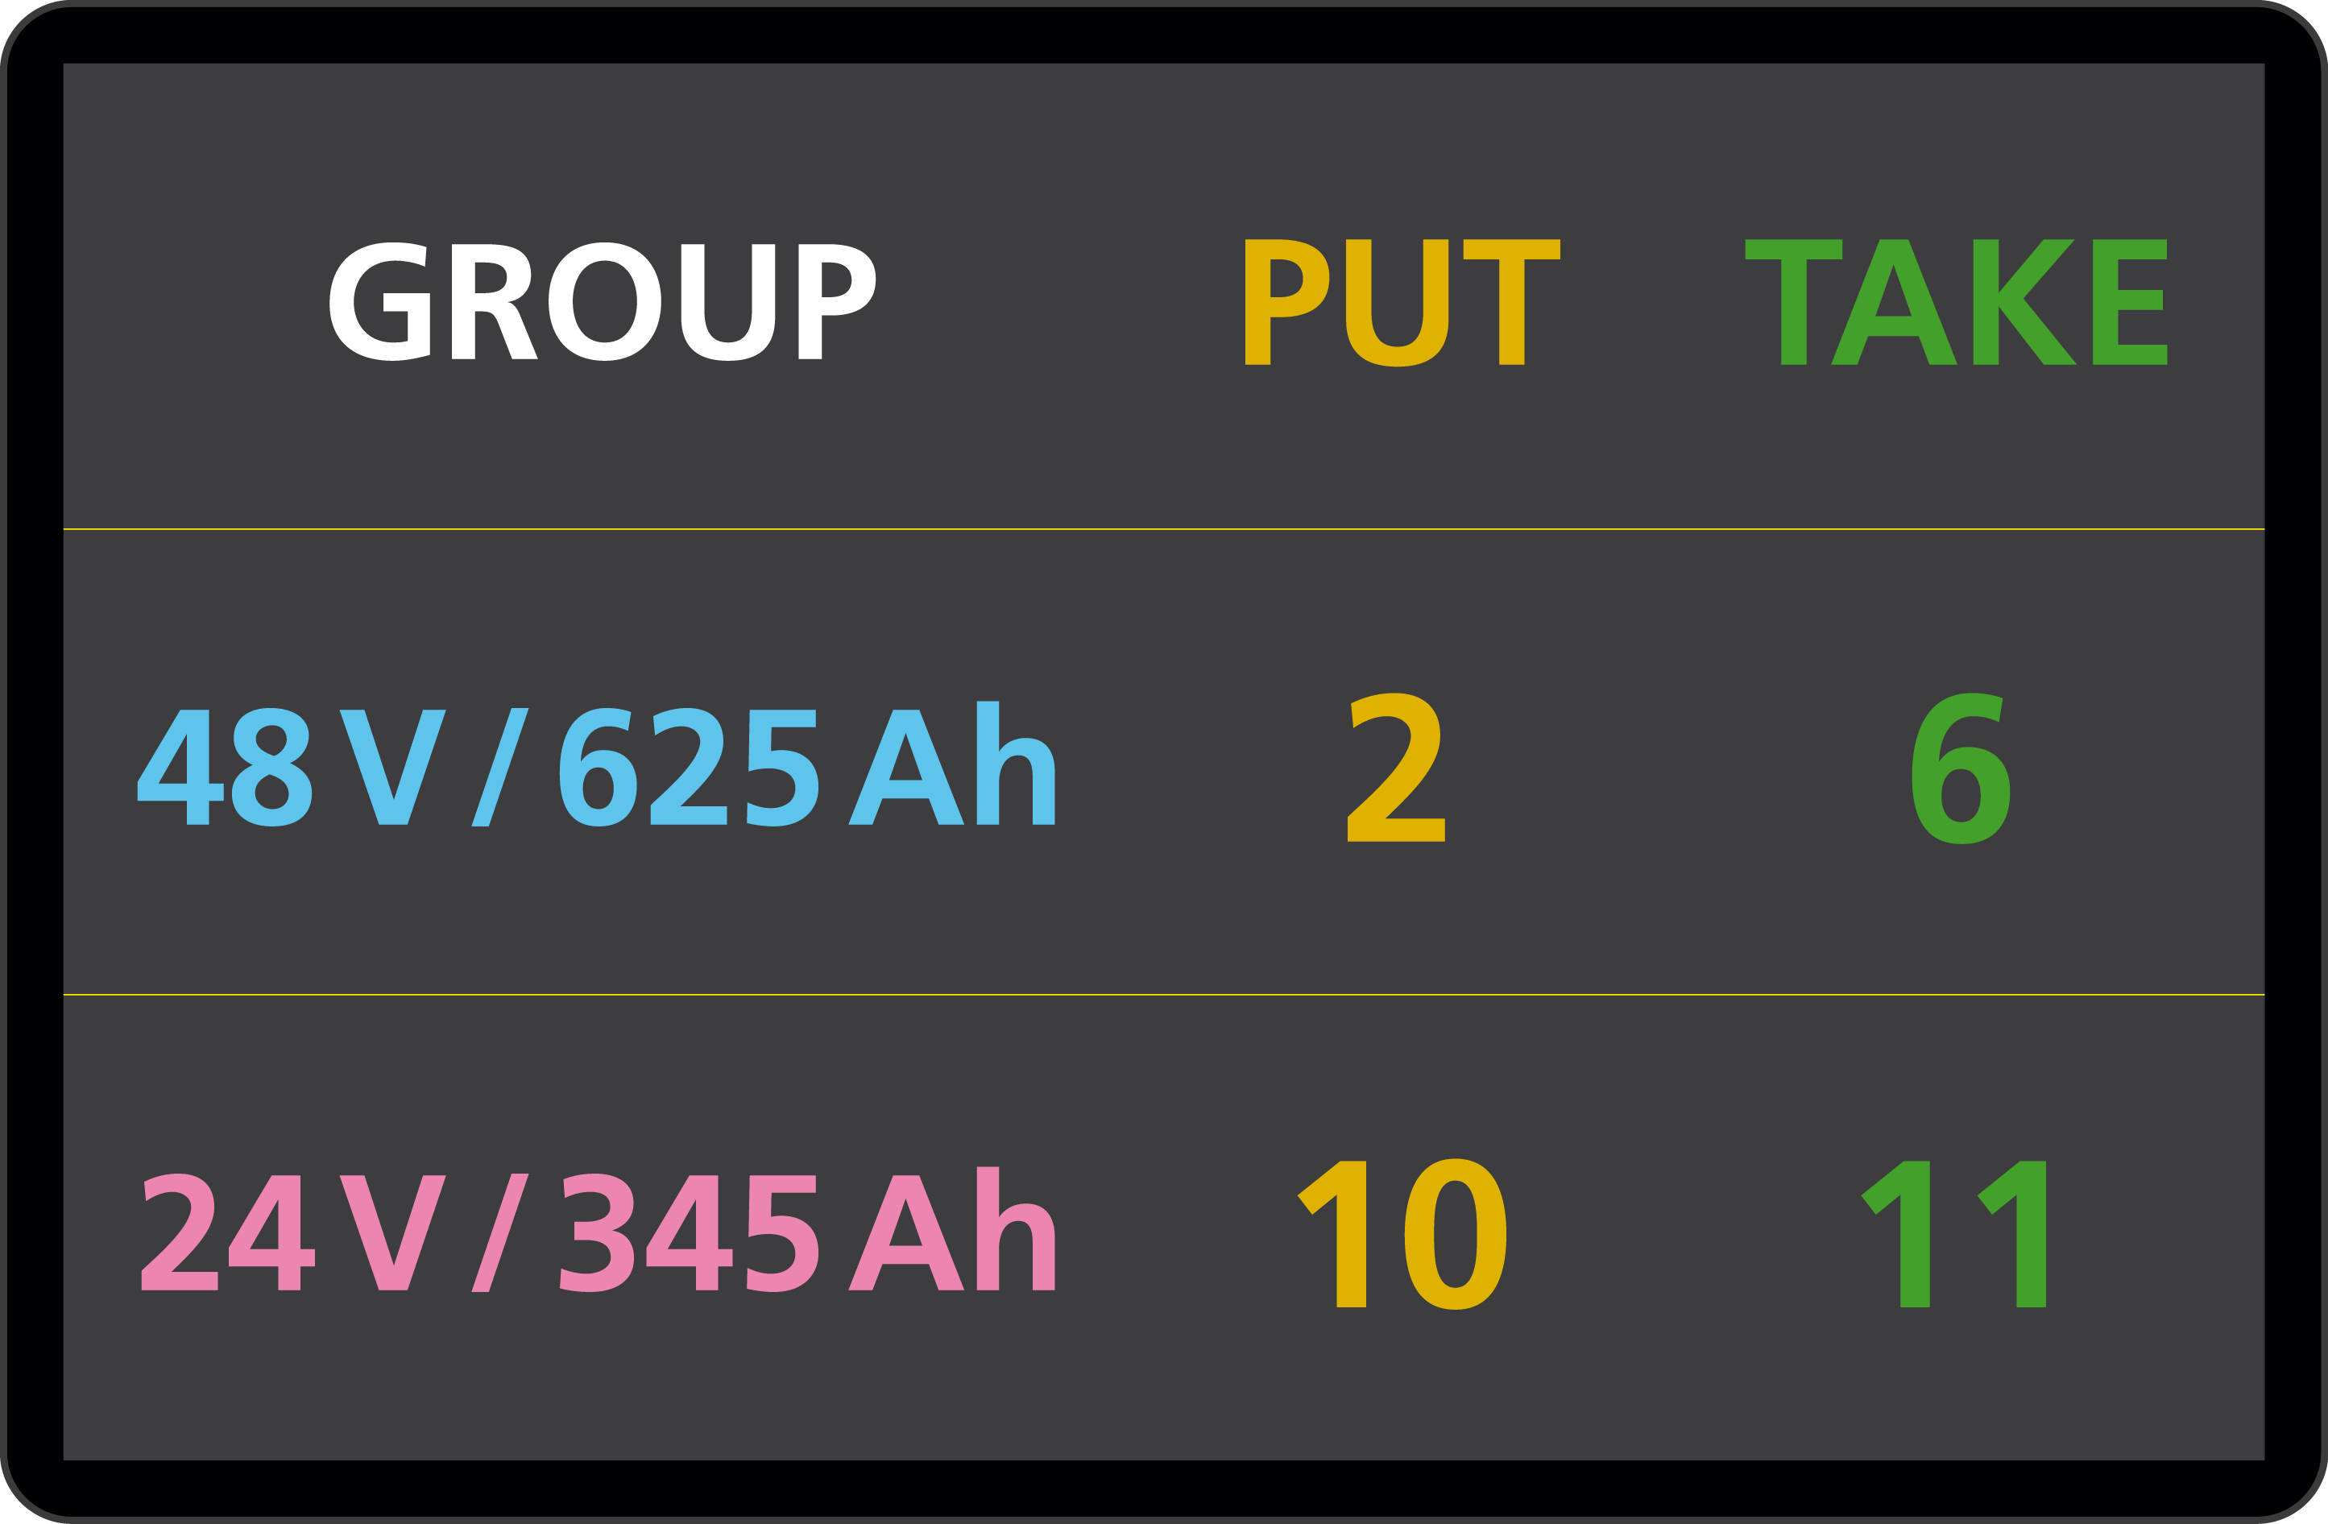
Hardware Parts
Control unit contains:
Ethernet ports
SIM card slot
LED and sound signalization
WiFi + LTE antenna
Optional equipment:
Wireless QR scanner
Industrial monitor
|

Slide 9
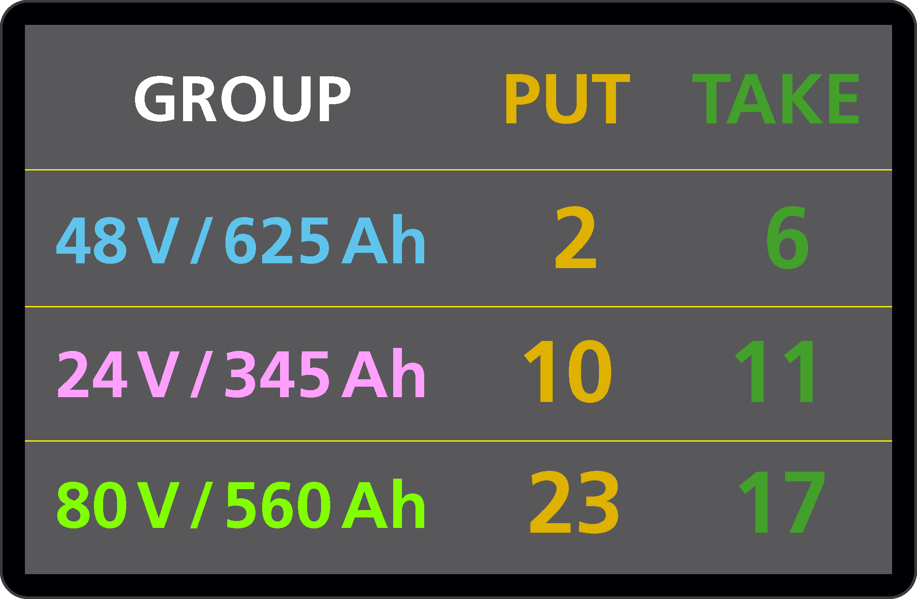
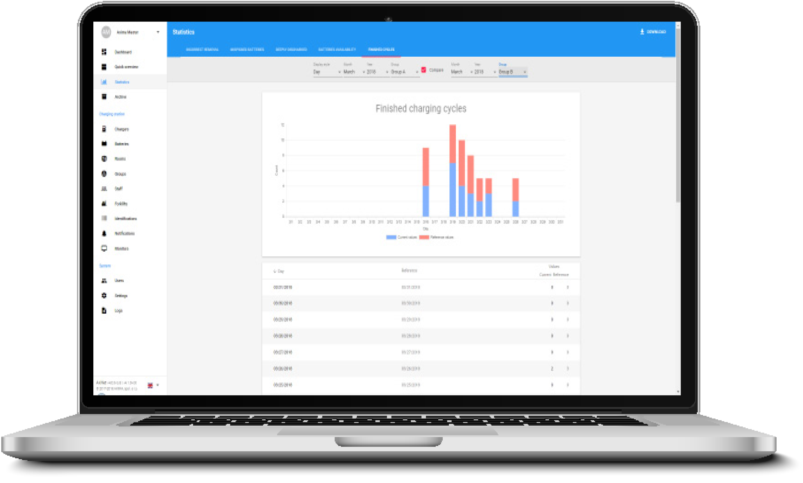
Software Modules
Basic
Monitors
Statistics
Identification
Remote access and reports
www.axinet.cz
|

Slide 10
Battery Exchange
AXINET system allows 4 modes of battery exchange.
TAKE
PUT and TAKE
TAKE and PUT
SWAP
|

Slide 11
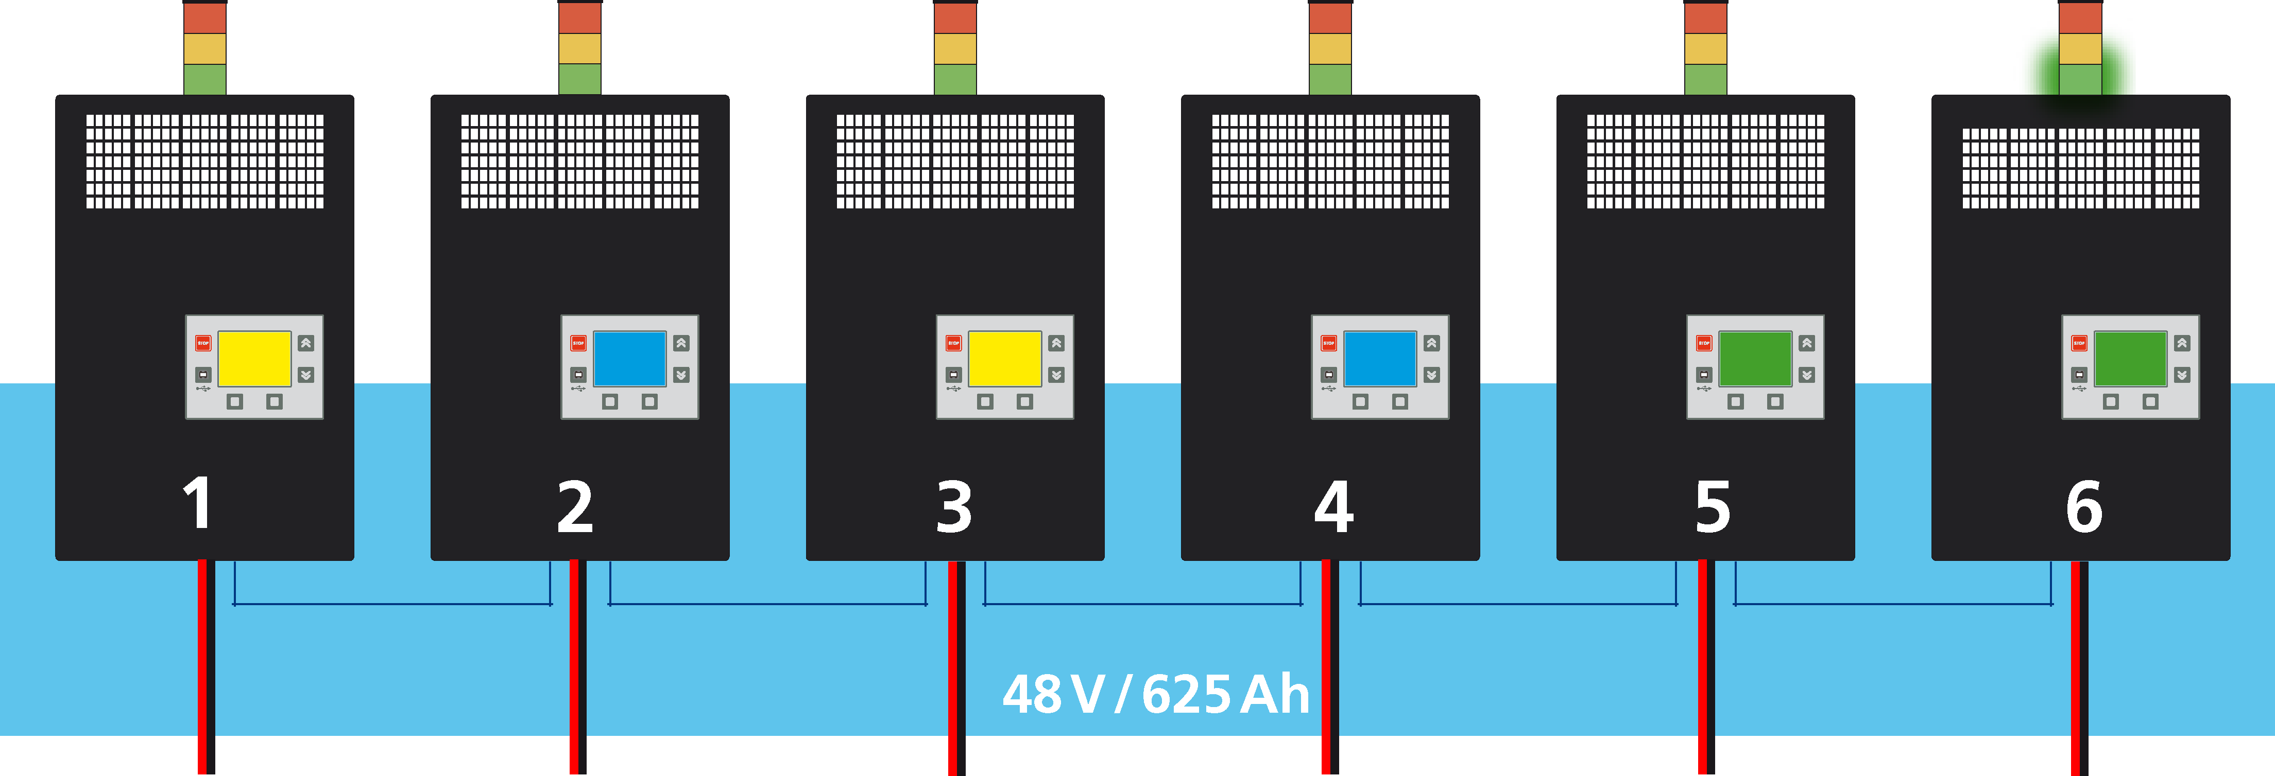
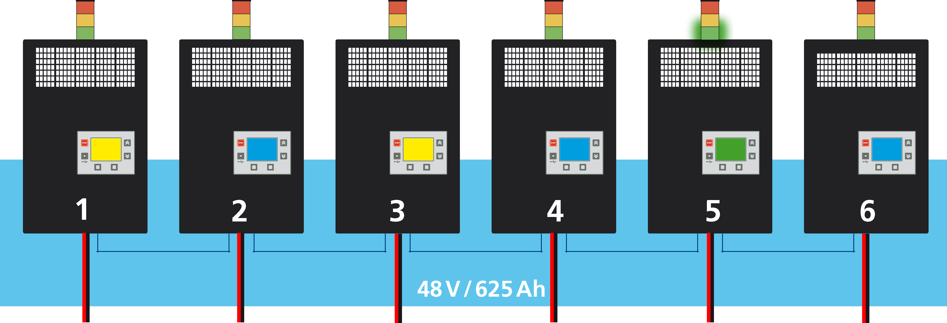
Battery Exchange
TAKE
|

Slide 12
Battery Exchange
TAKE + monitor
|

Slide 13
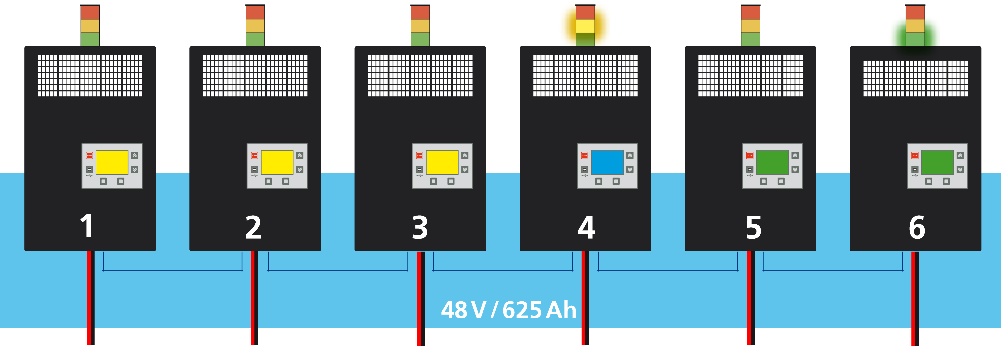
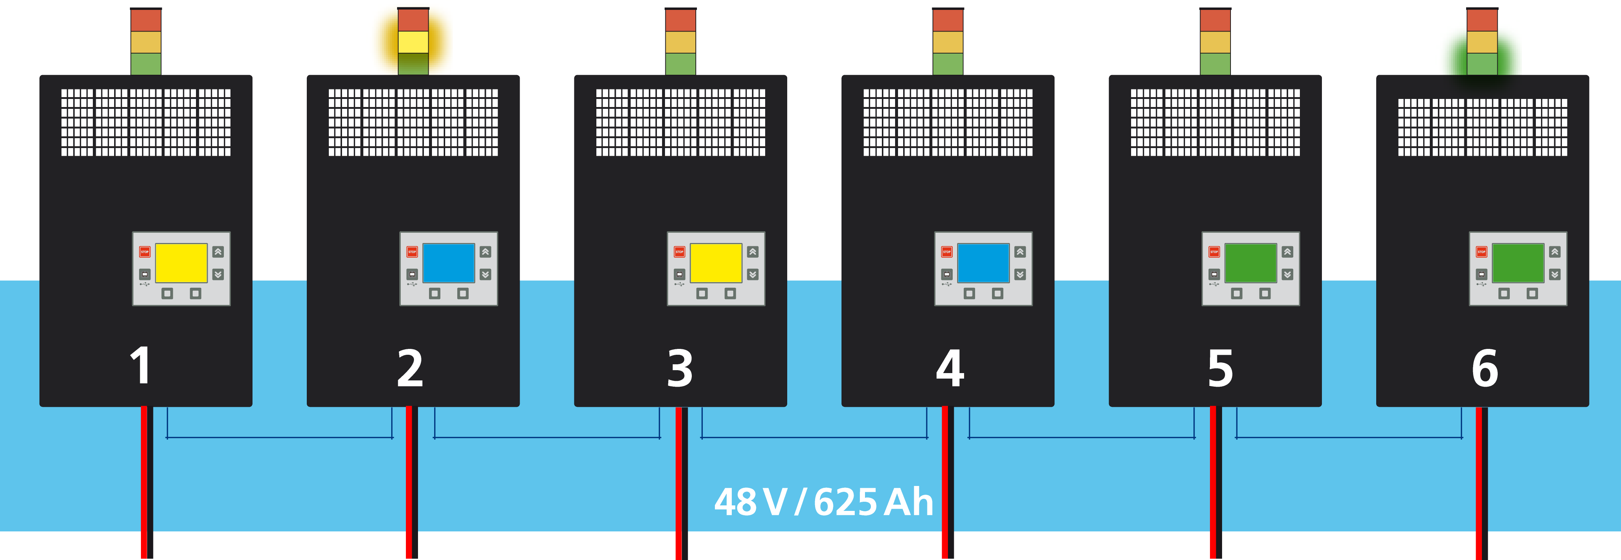
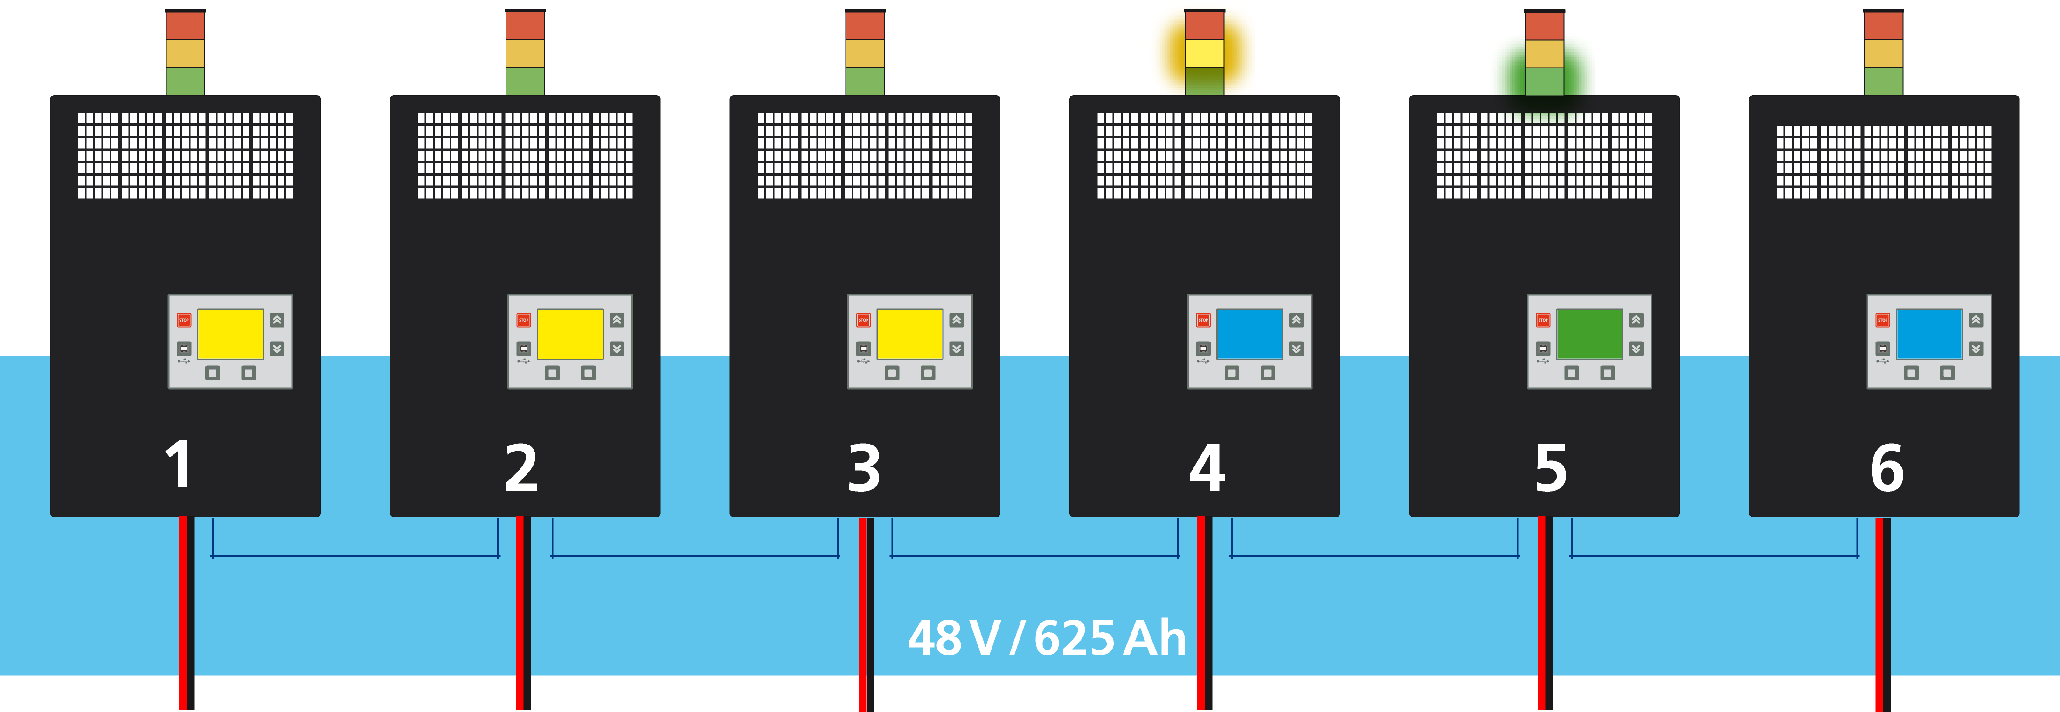
Battery Exchange
PUT and TAKE
|

Slide 14
Battery Exchange
PUT and TAKE + monitor
|

Slide 15
Battery Exchange
TAKE and PUT + monitor
|

Slide 16
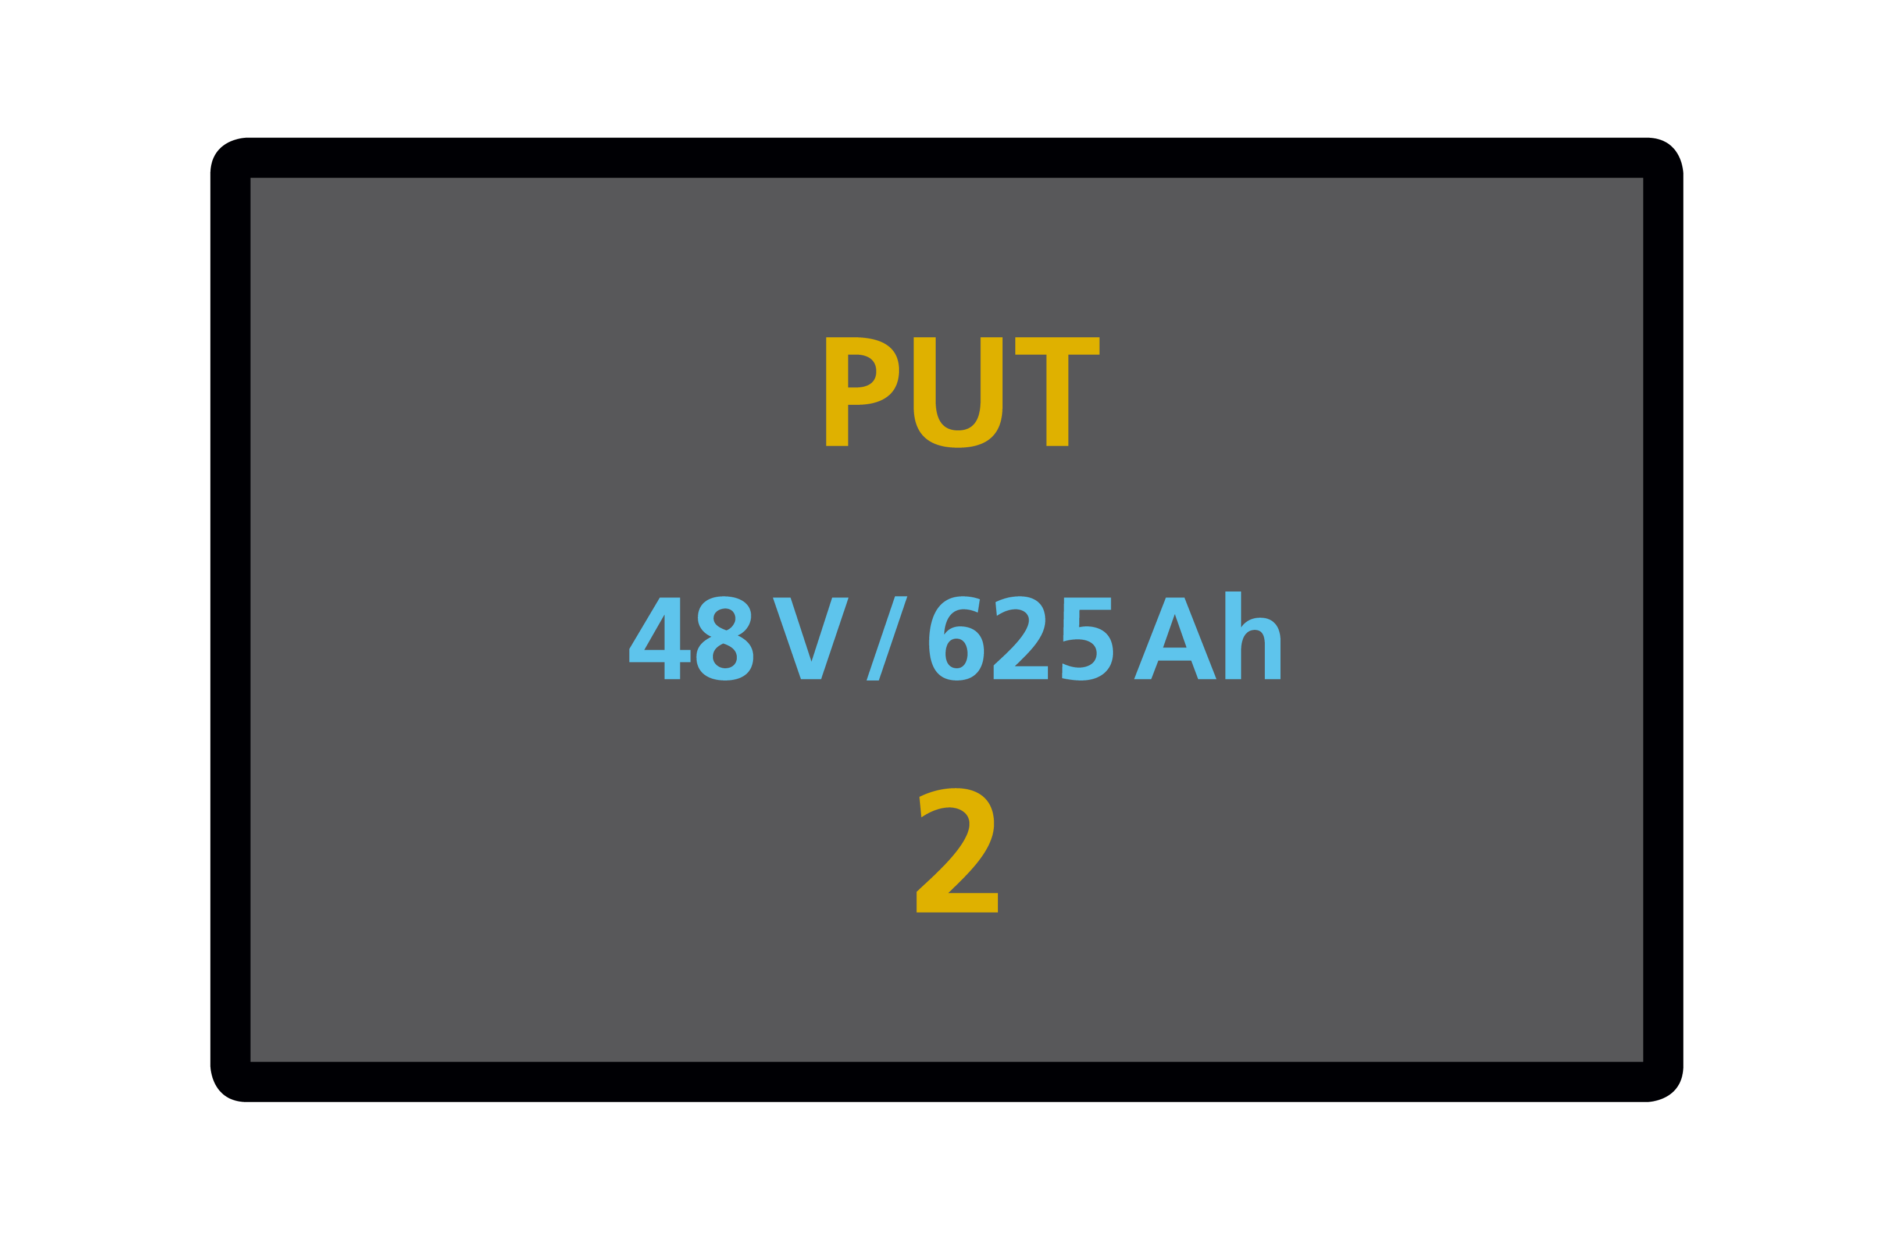
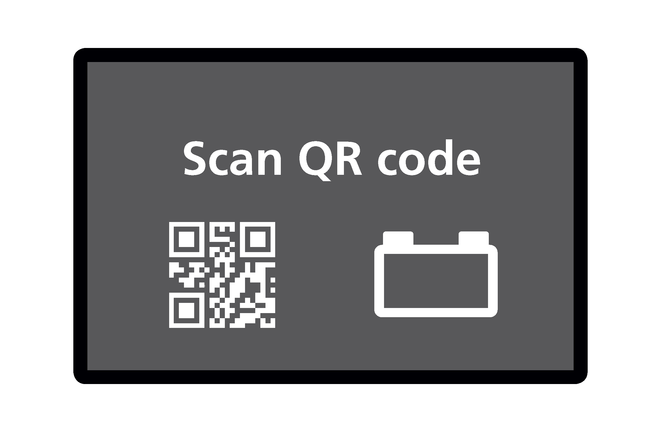
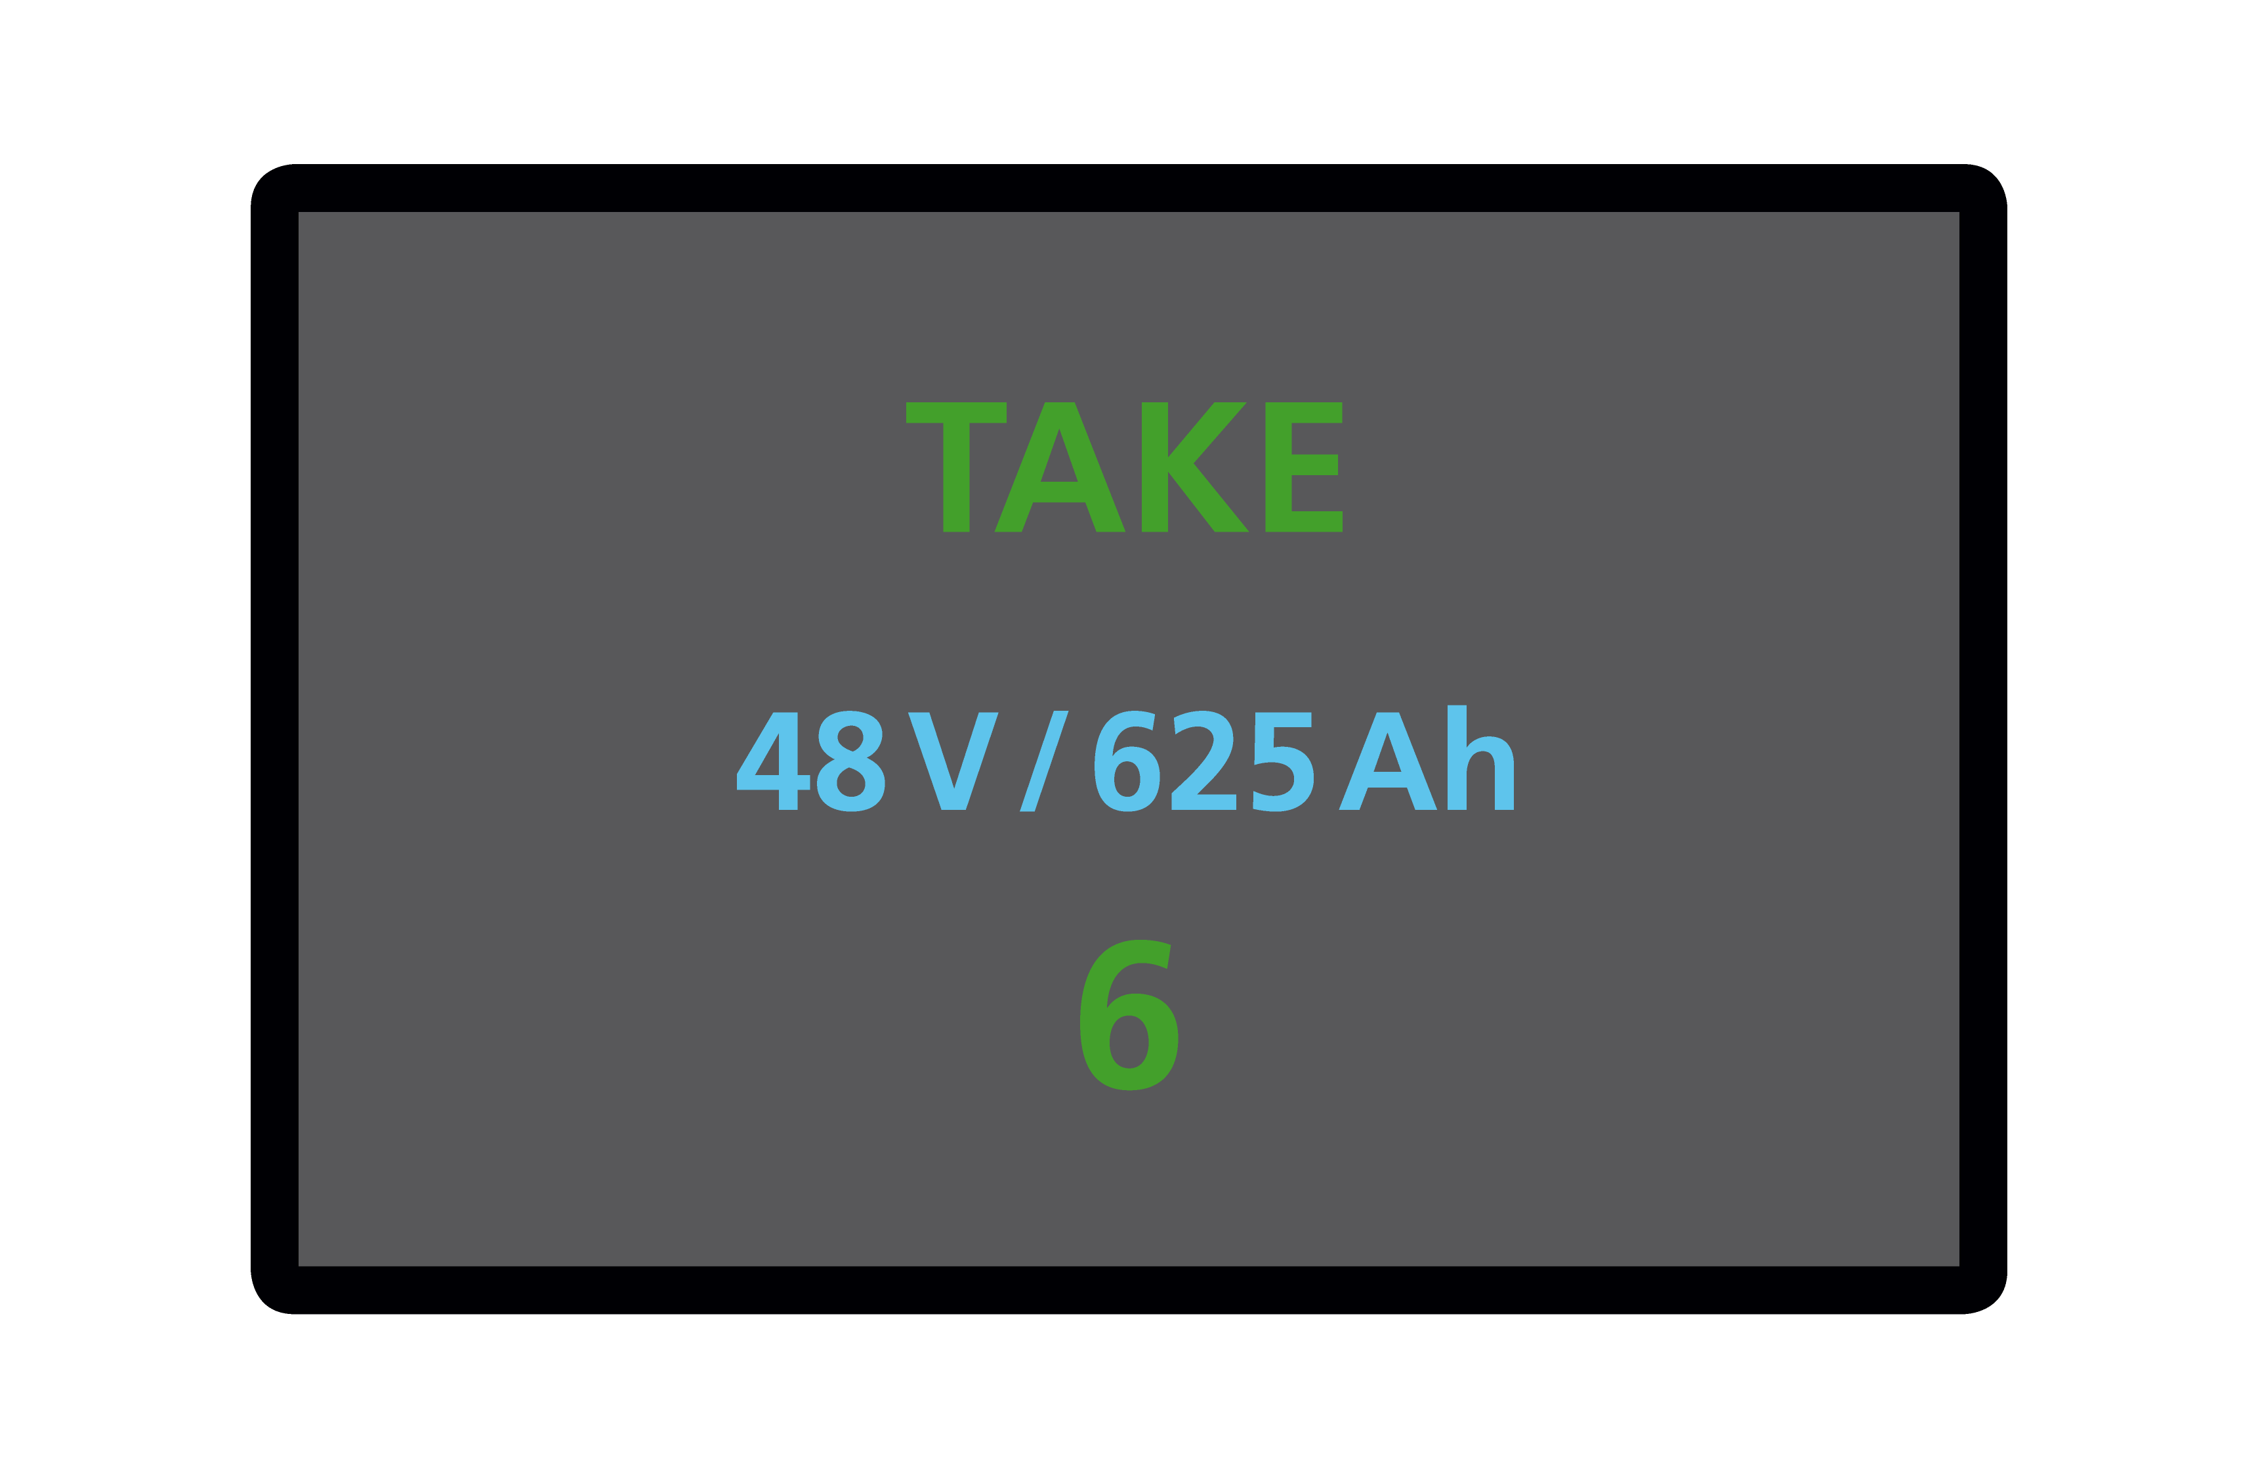
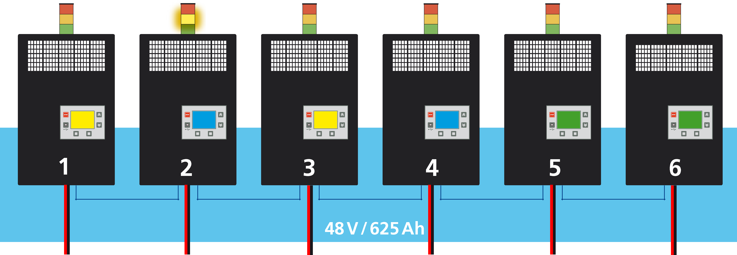
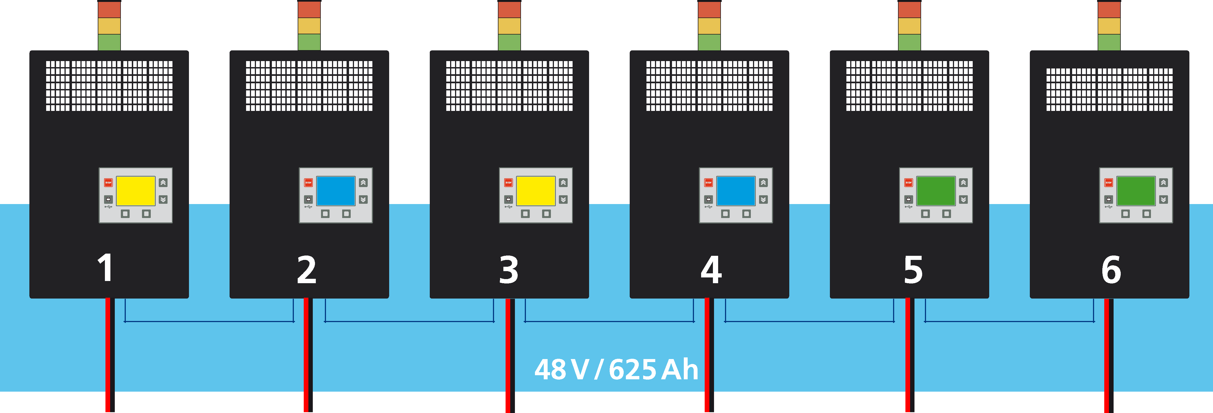
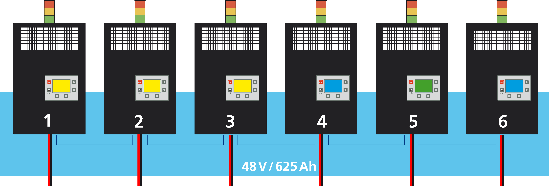
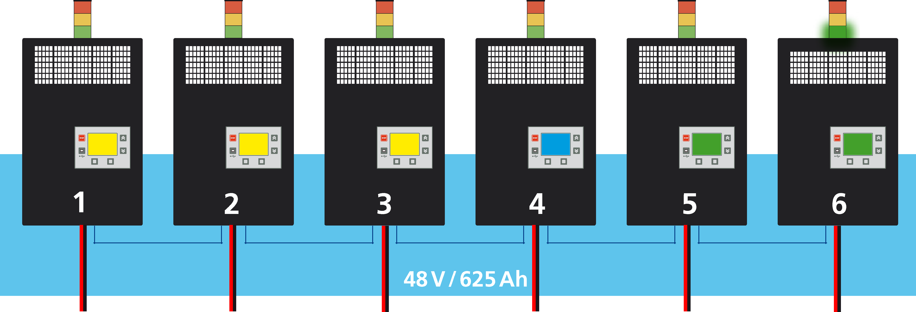
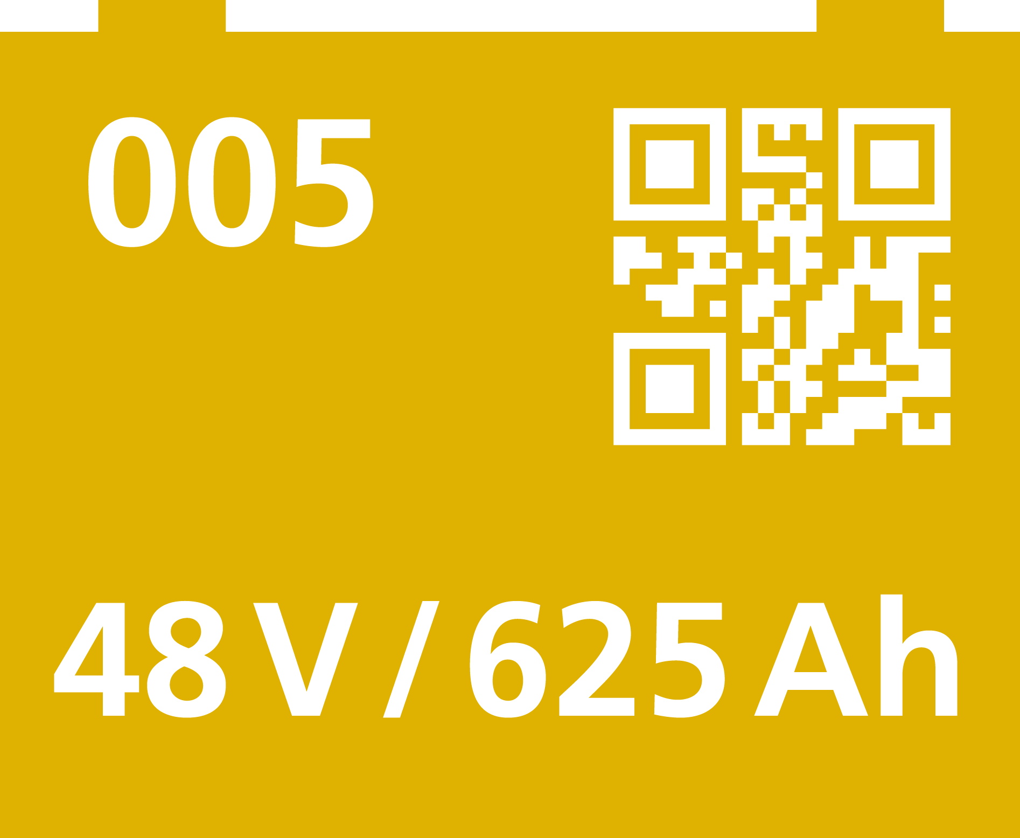
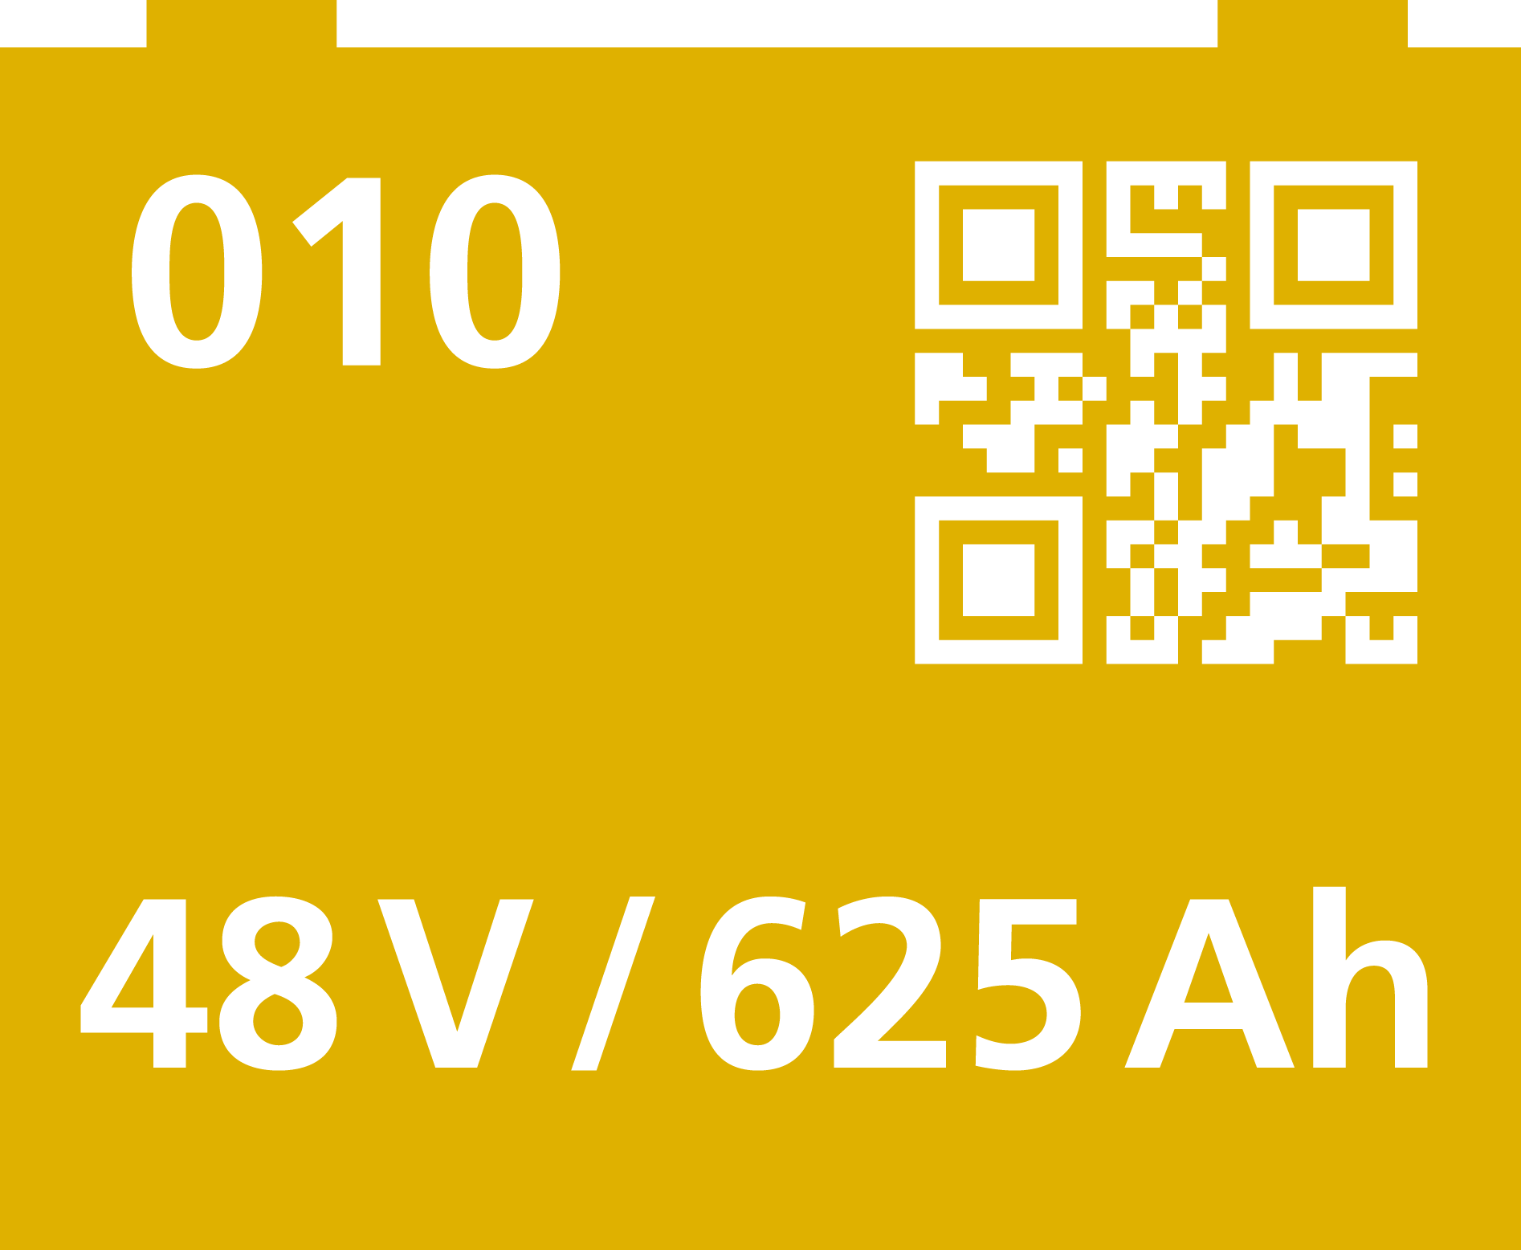
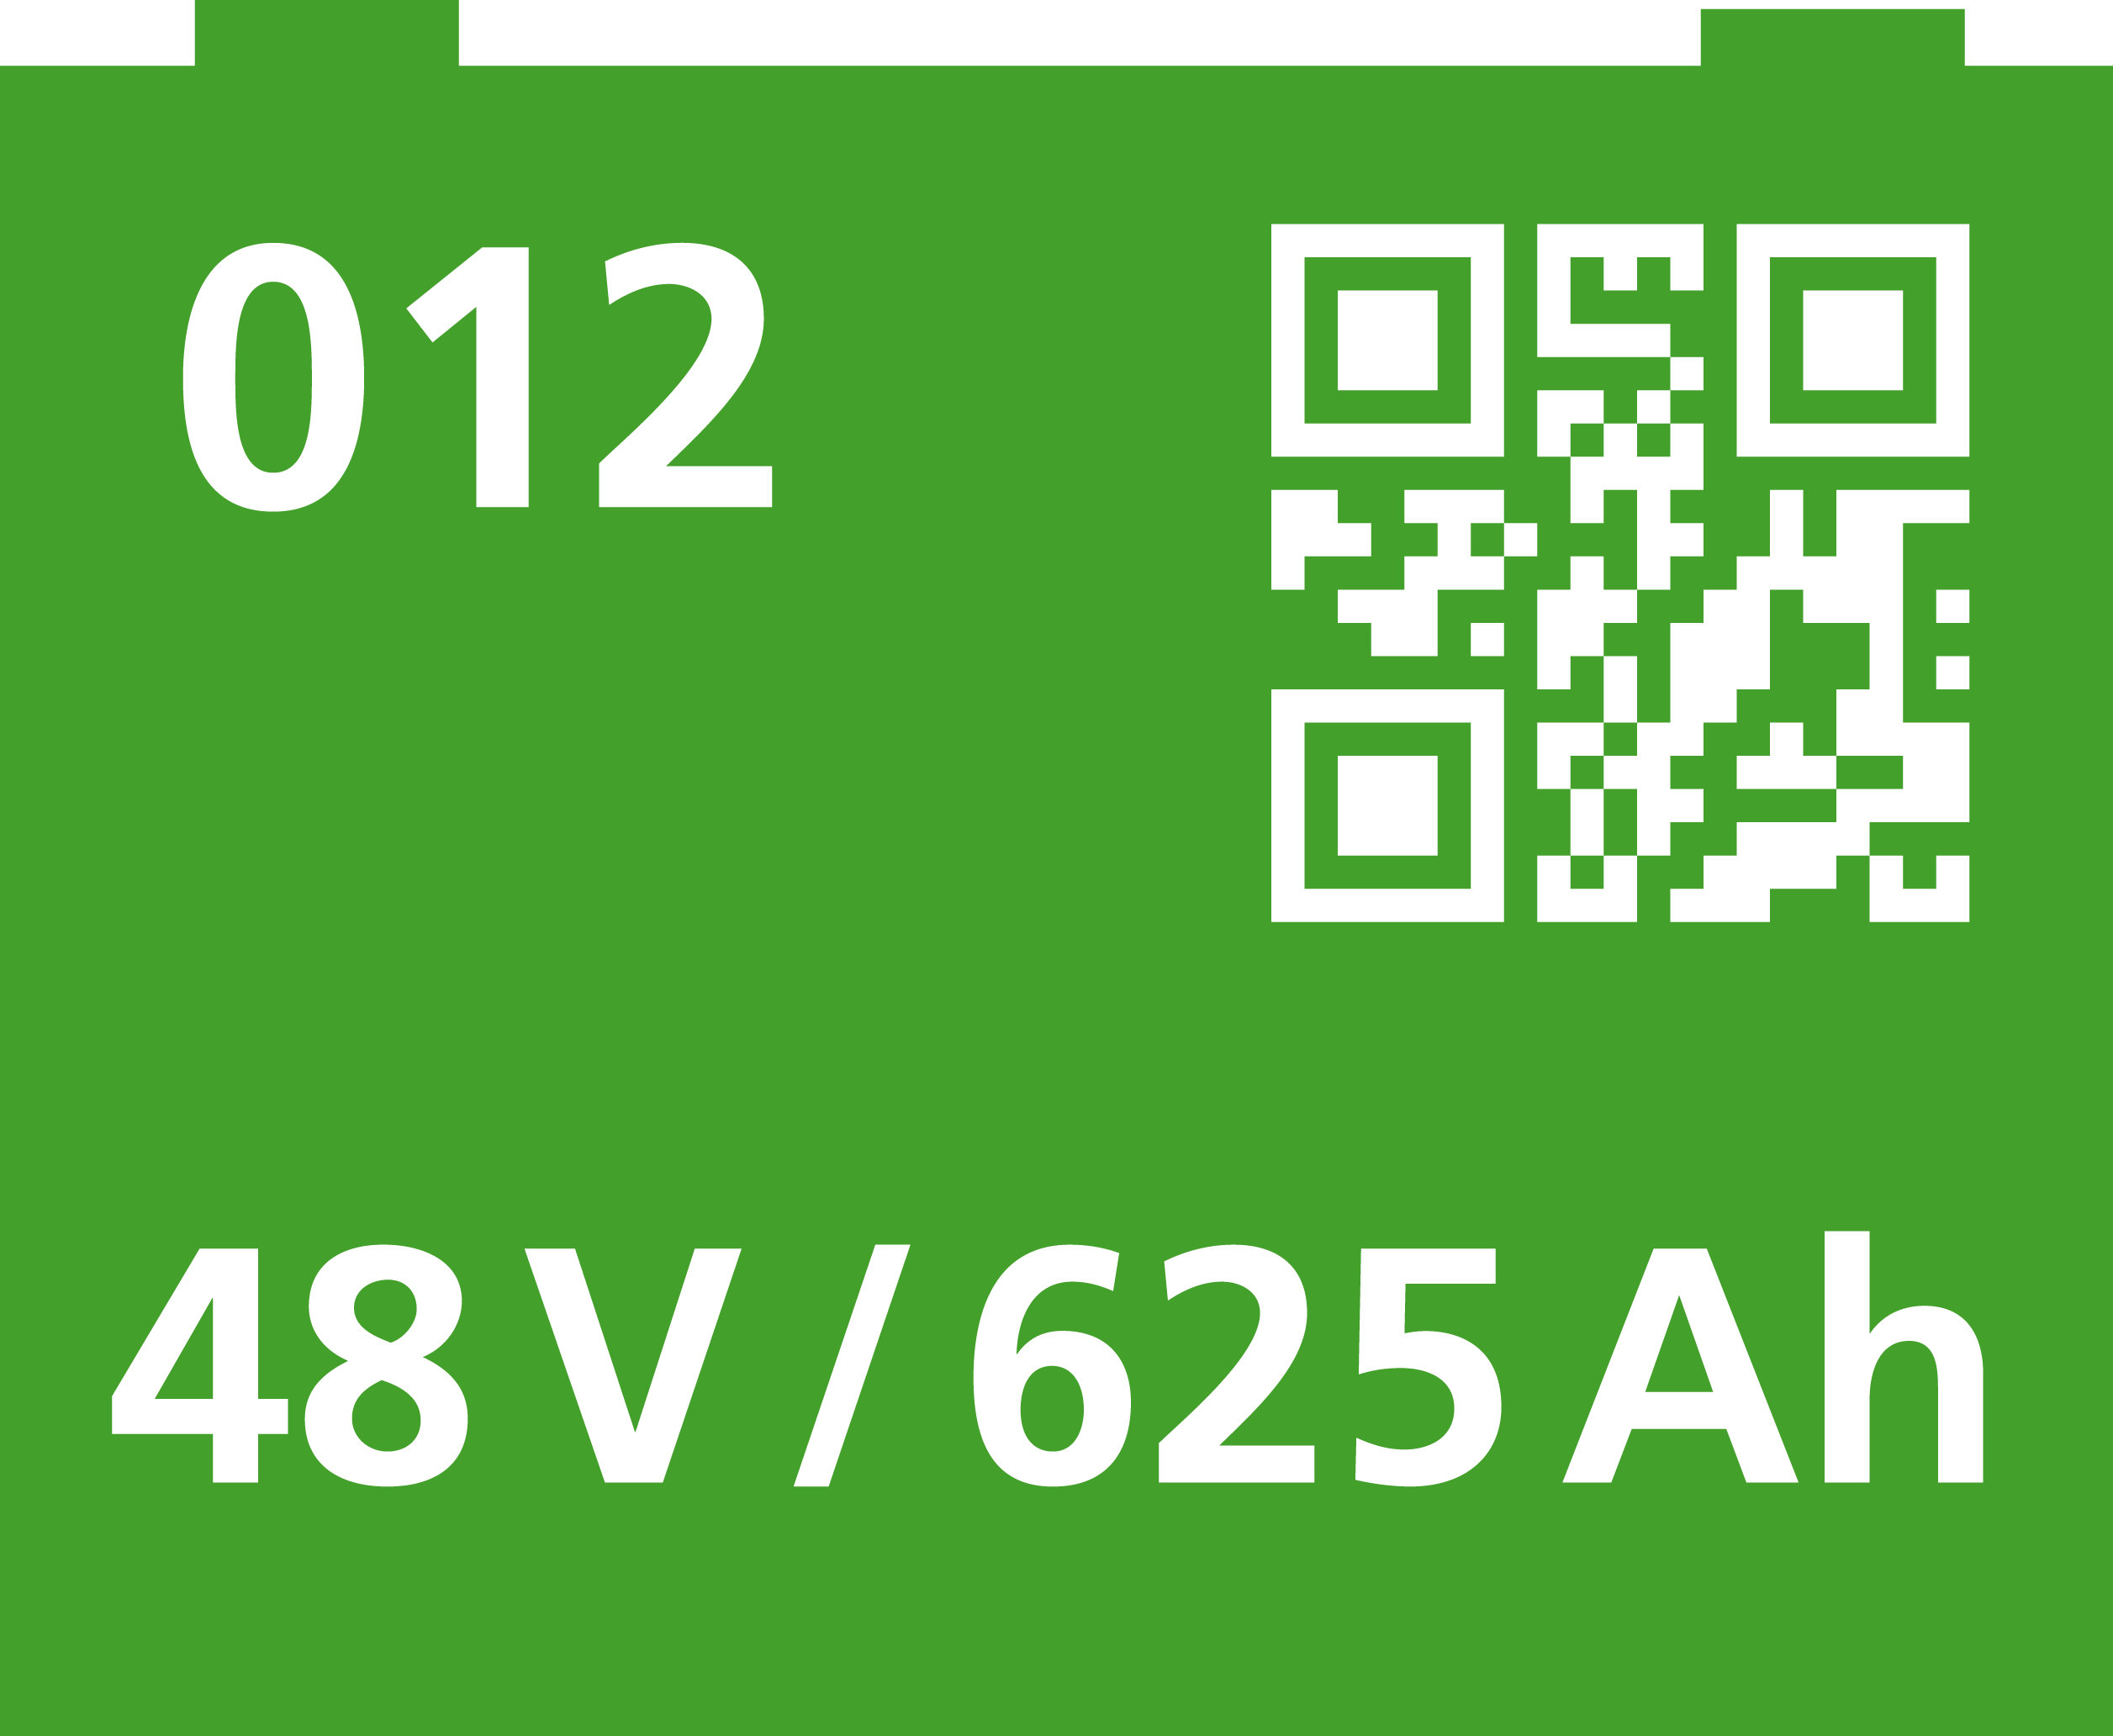
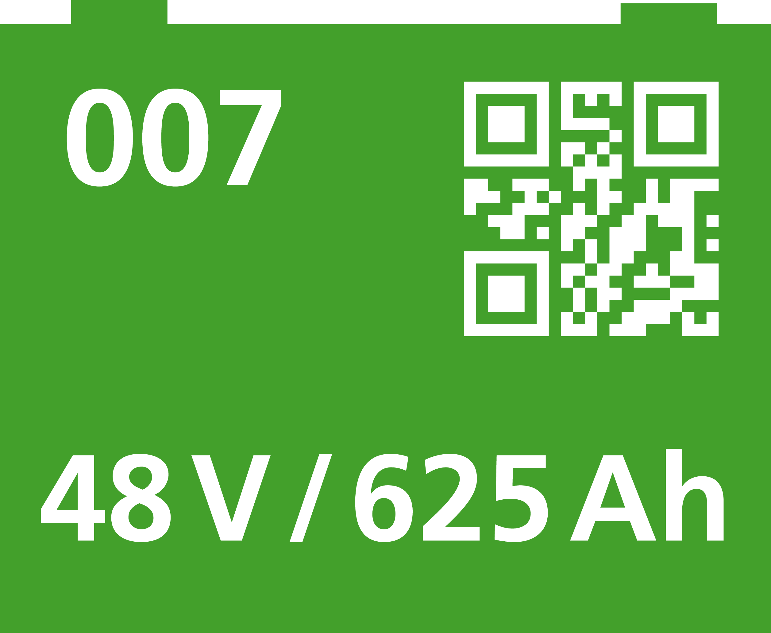
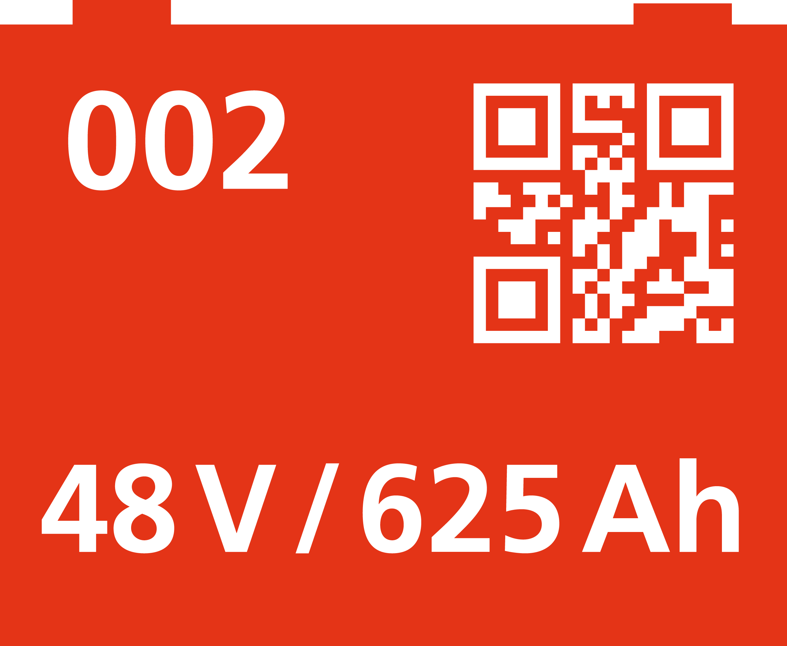
Způsoby výměny baterií
Battery Exchange
PUT and TAKE + monitor + QR scanner
|

Slide 17
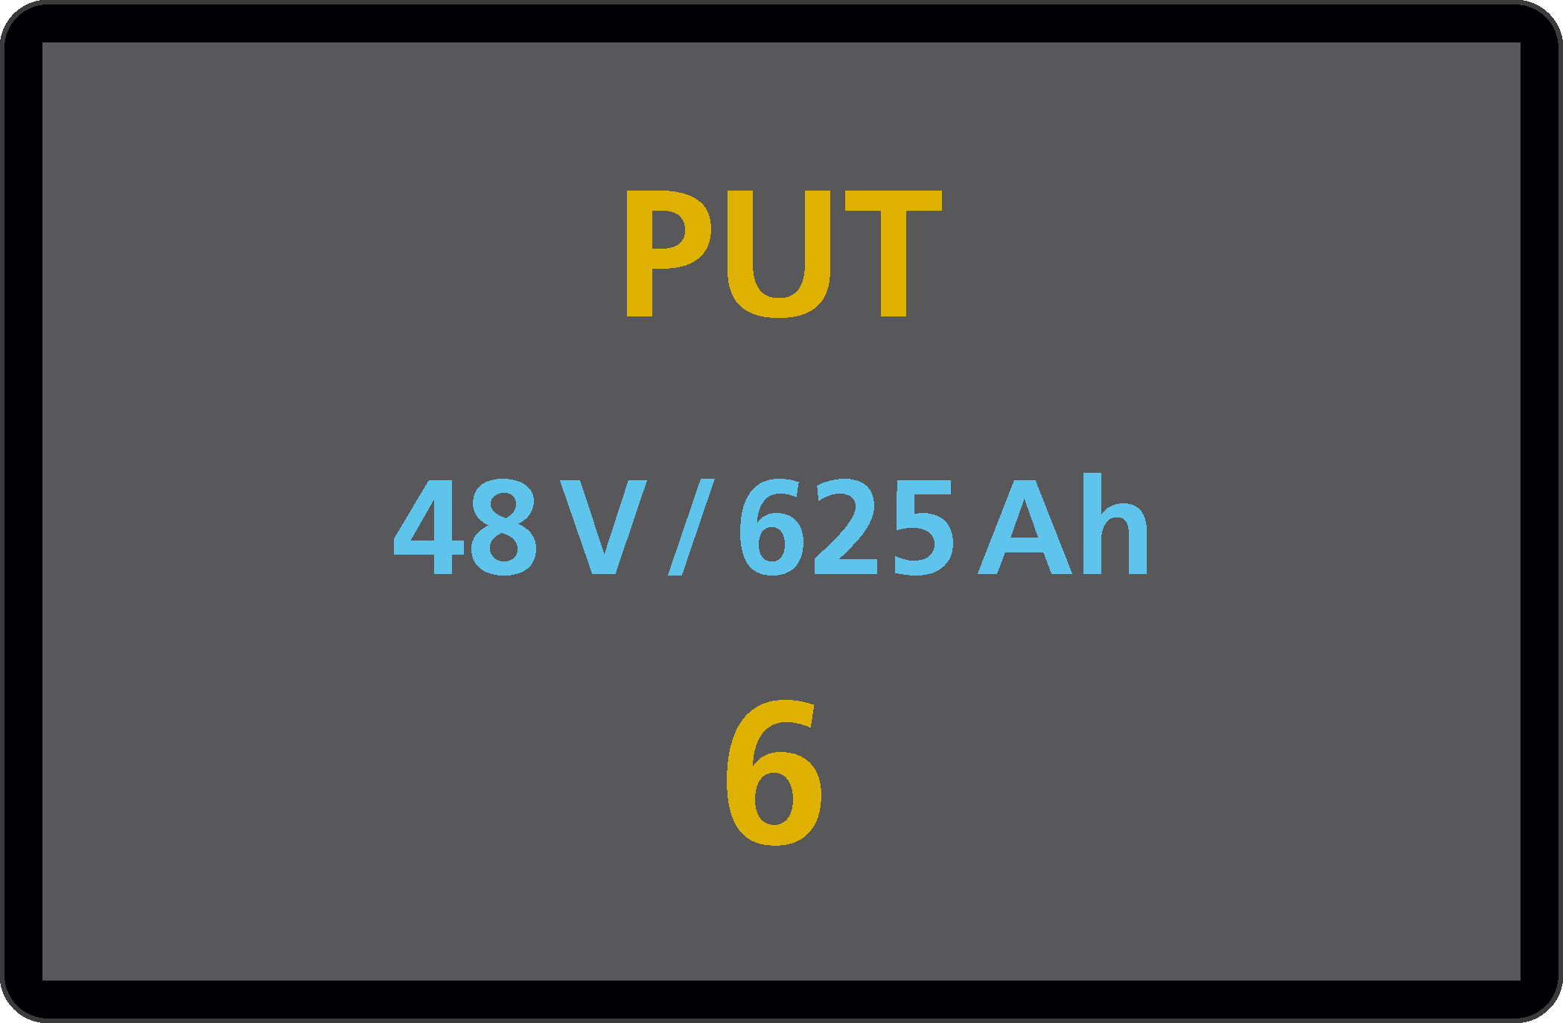
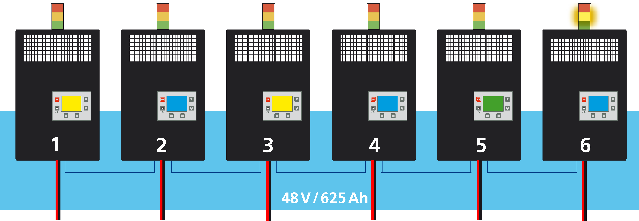
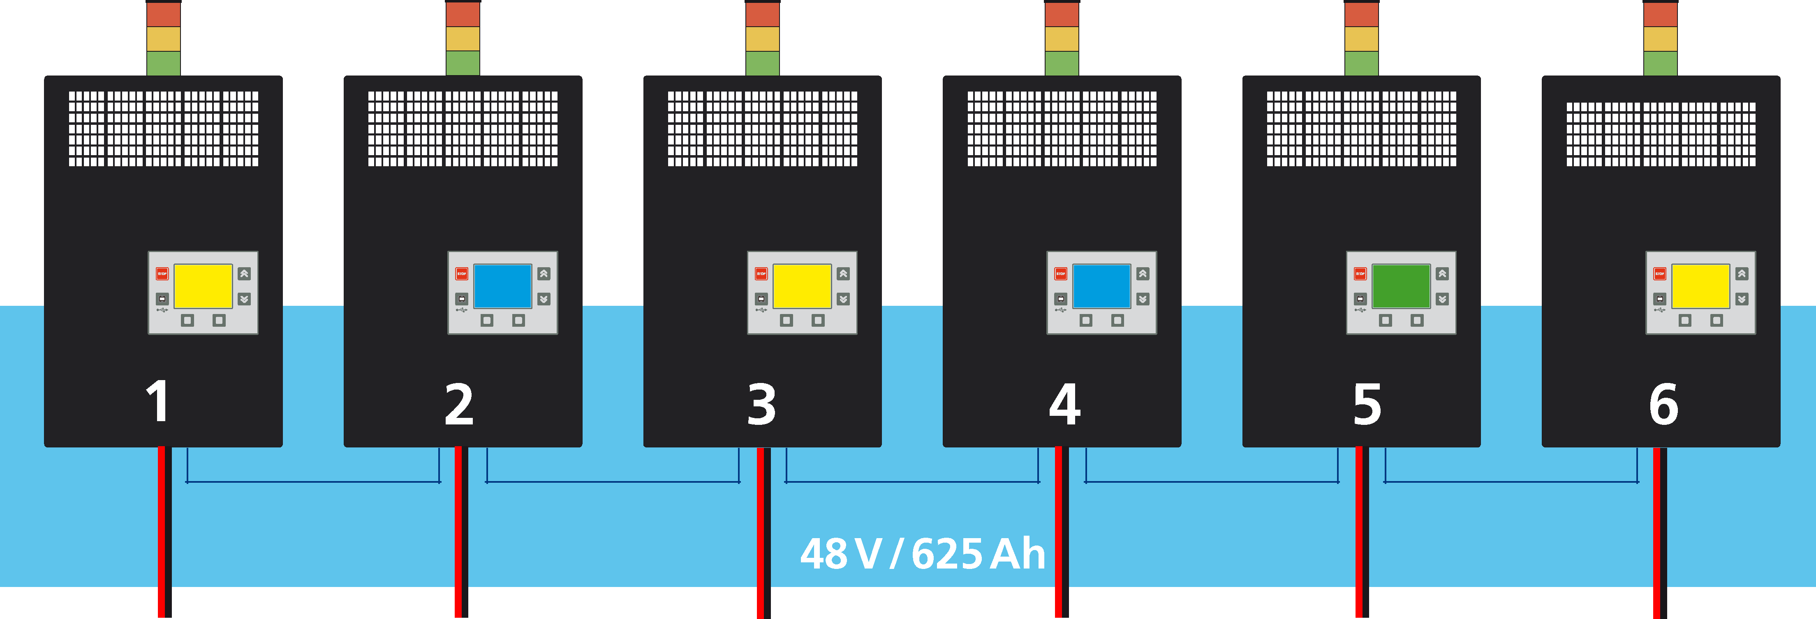
Battery Exchange
SWAP + monitor + QR scanner
|

Slide 18
Main Features
Up to 255 chargers divided into groups by battery type, forklift type...
LED Signalization on chargers for PUT the discharged battery and TAKE the right charged battery
Sophisticated web app for easy setting, shows the state of chargers, the archive of charging cycles...
Identification of batteries, staff, and forklifts
Remote access and reports
Statistics of battery use, operations…
The system reduces costs and increases effectivity
|

Slide 19
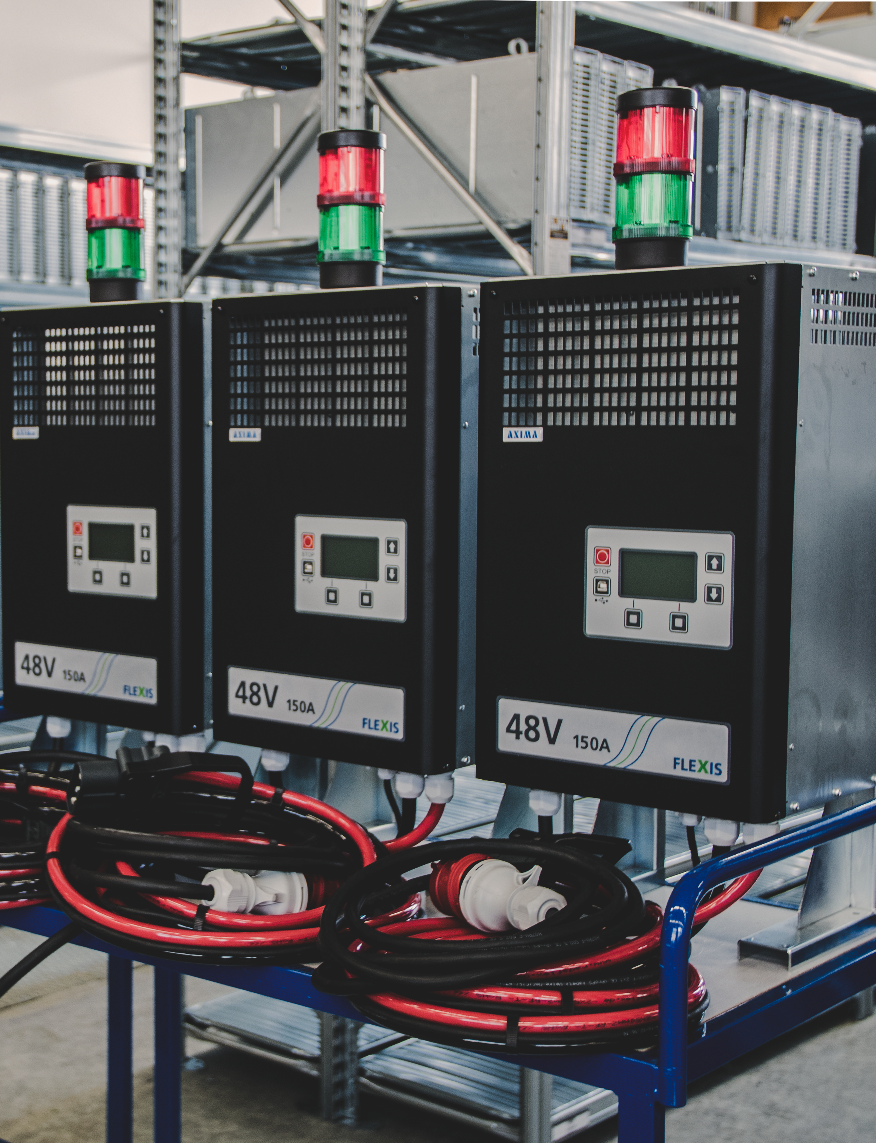
Thank you for your attention

